Slide 1



Harmony: Heterogeneous Multi-Modal Federated Learning through Disentangled Model Training
Xiaomin Ouyang¹, Zhiyuan Xie¹, Heming Fu¹, Sitong Chen¹, Li Pan¹, Neiwen Ling¹, Guoliang Xing¹, Jiayu Zhou², and Jianwei Huang³
¹The Chinese University of Hong Kong, ²Michigan State University,
³The Chinese University of Hong Kong, Shenzhen
Notes:
Good afternoon everyone, I am Xiaomin Ouyang. This is a joint work with several collaborators and my advisor Prof. Guoliang Xing.

Slide 2
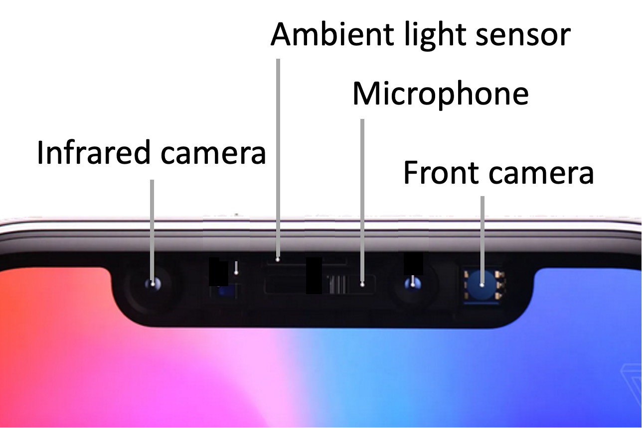
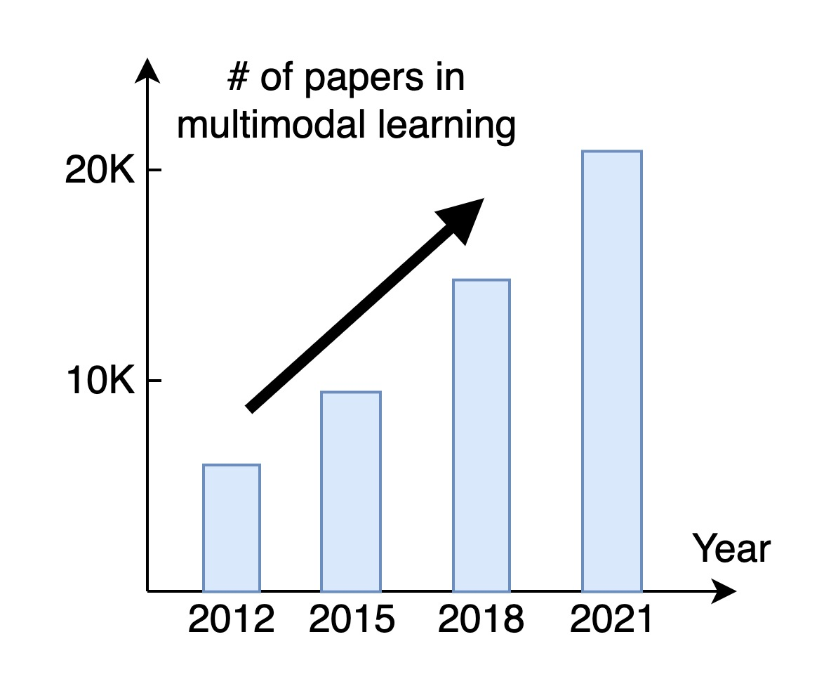

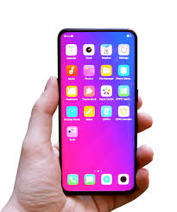

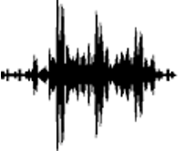
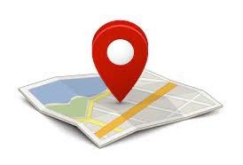
Multi-Modal Sensing Systems
Emerging Studies
VR devices
Smartphone
Centralized Learning: privacy concern
Server
Autonomous vehicle
Notes:
Many mobile devices today have multiple sensors of different modalities. For example, the latest VR headset released by Apple integrates RGB camera, Lidar sensors and depth cameras. Combining the three sensors together will enable lots of VR applications. Other representative multi-modal sensing systems include smartphones and autonomous vehicles. These devices are increasingly running machine learning systems based on the multi-modal sensors.
However, traditional centralized learning approaches can impose significant privacy concerns because of data sharing. e.g., in a smartphone-based health monitoring system, if we upload data of multiple sensors on the phone, this will lead to a higher risk of privacy leakage.
Multi-modal easy to leak privacy (smartphone),
(add sensor data)
most of them focus on centralized learning approaches, which imposes significant privacy concerns because of sharing raw data.
举个例子
不動鼠標, multi-modal 到privacy不是很直接
##Multi-modal sensing systems are increasingly deployed in real-world applications

Slide 3
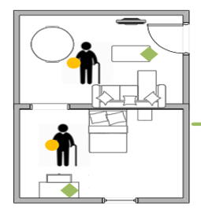



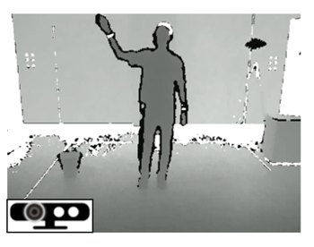
Federated Learning (FL)
Enables collaboratively training models while keeping the data residing on devices.
Server
New global model
Local model update
Data of a single sensor modality
Notes:
A typical solution to address the privacy concern is to use federated learning. The basic idea is to enable collaborative model training while keeping the data residing on devices,
However, most of the existing FL approaches focus on training unimodal networks with data input from only a single sensor modality.
##, which cannot be directly applied to heterogeneous multi-modal sensing systems.

Slide 4
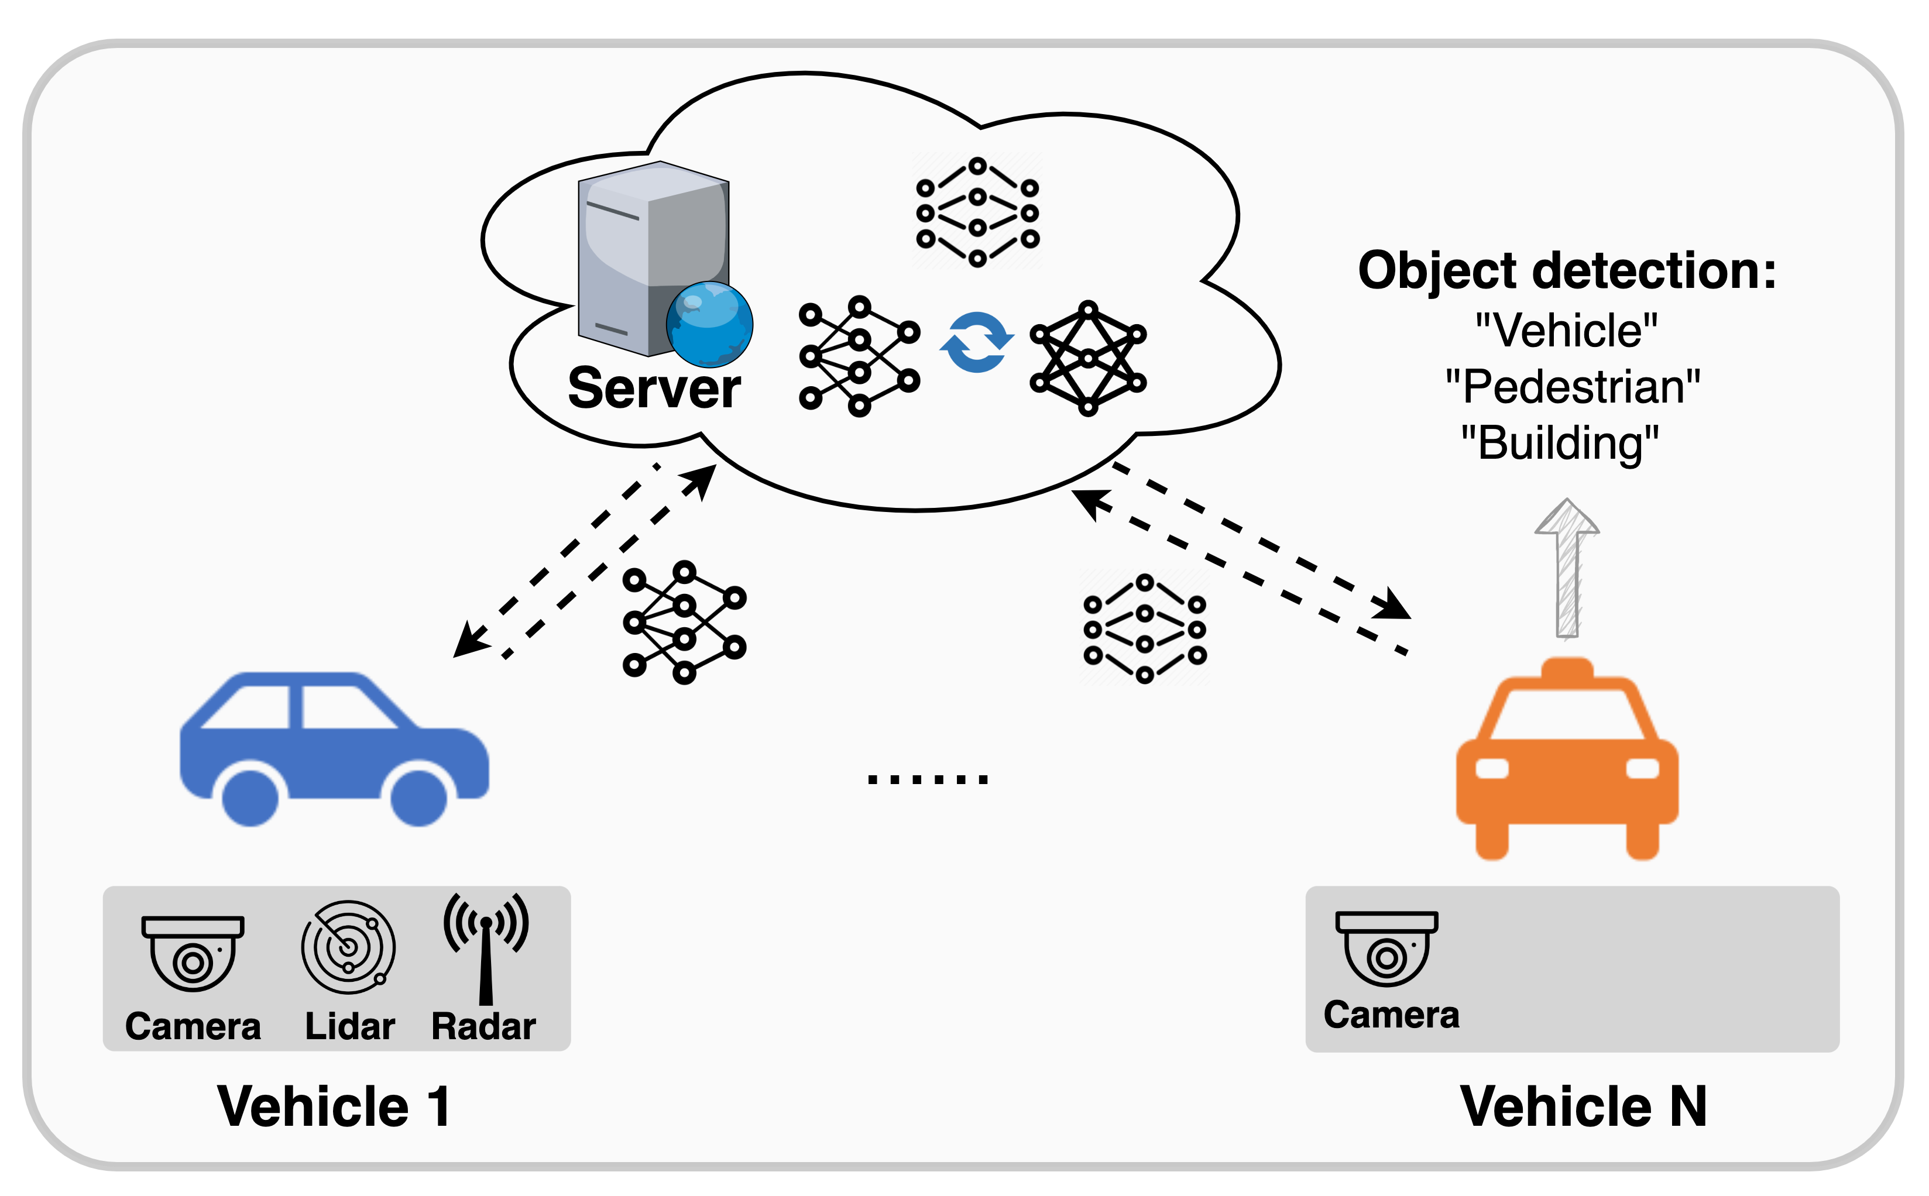
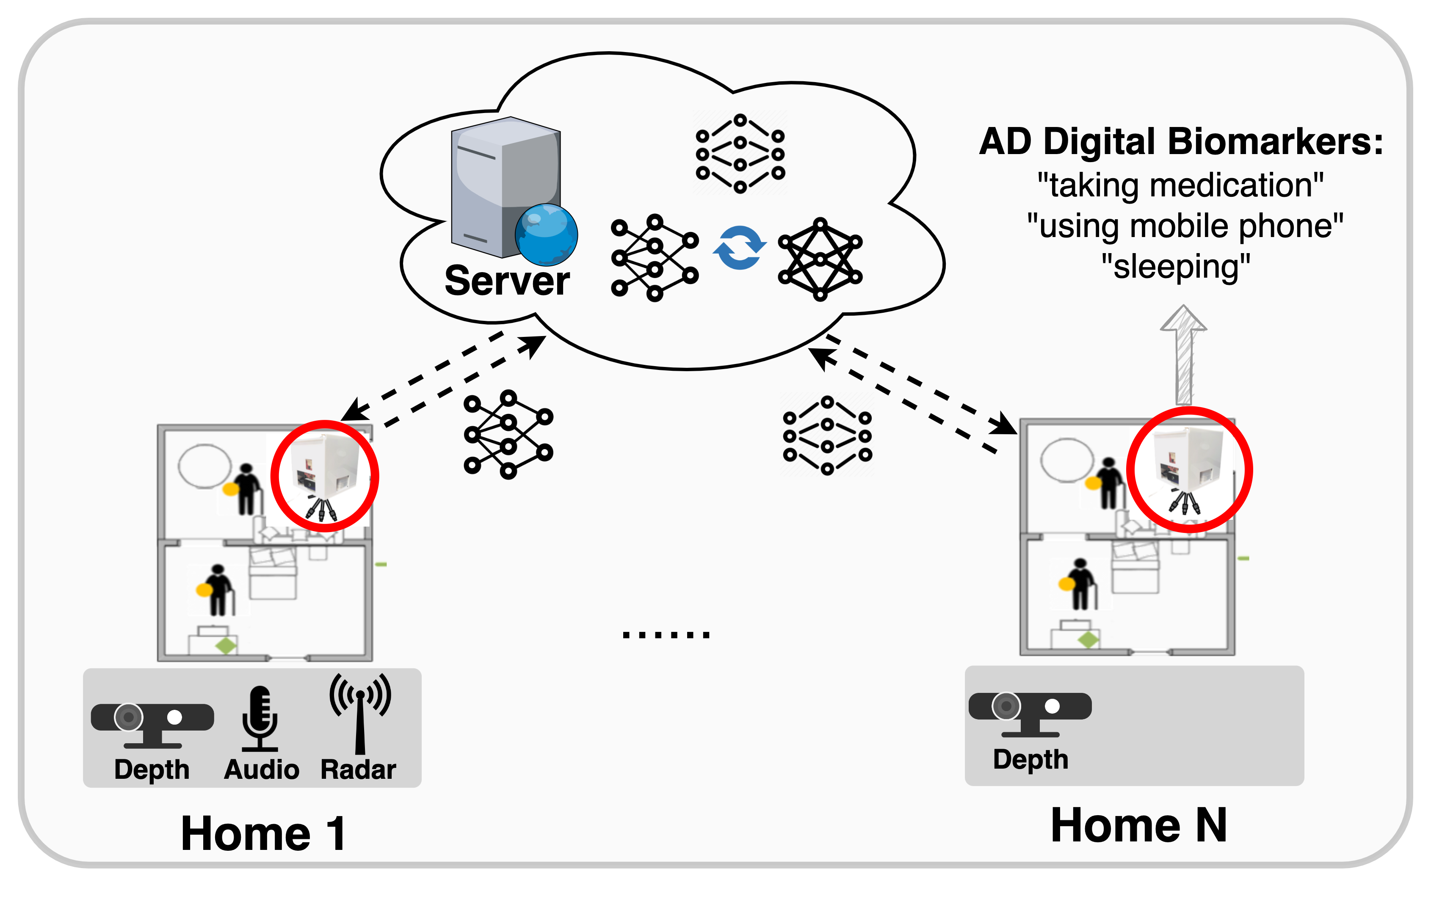
Multi-Modal Federated Learning
Collaborative model training + distributed sensor fusion.
Autonomous driving
Alzheimer’s patient monitoring
Notes:
In multi-modal sensor applications, federated learning can not only preserve privacy through collaborative model training, but also can enable sensor fusion across distributed devices. For example, FL can enable real-time fusion across different cars to improve the performance of autonomous driving. In another example, FL can aggregate models of various modalities across different homes. This will lead to more accurate and scalable behavior recognition.
##to capture subjects’ behaviors in Alzheimer’s patient monitoring such as taking medication and using mobile phone, we need to integrate information from multiple sensor modalities such as cameras, microphones, and radar sensors.
对比：Multi-modal FL的好处，

Slide 5
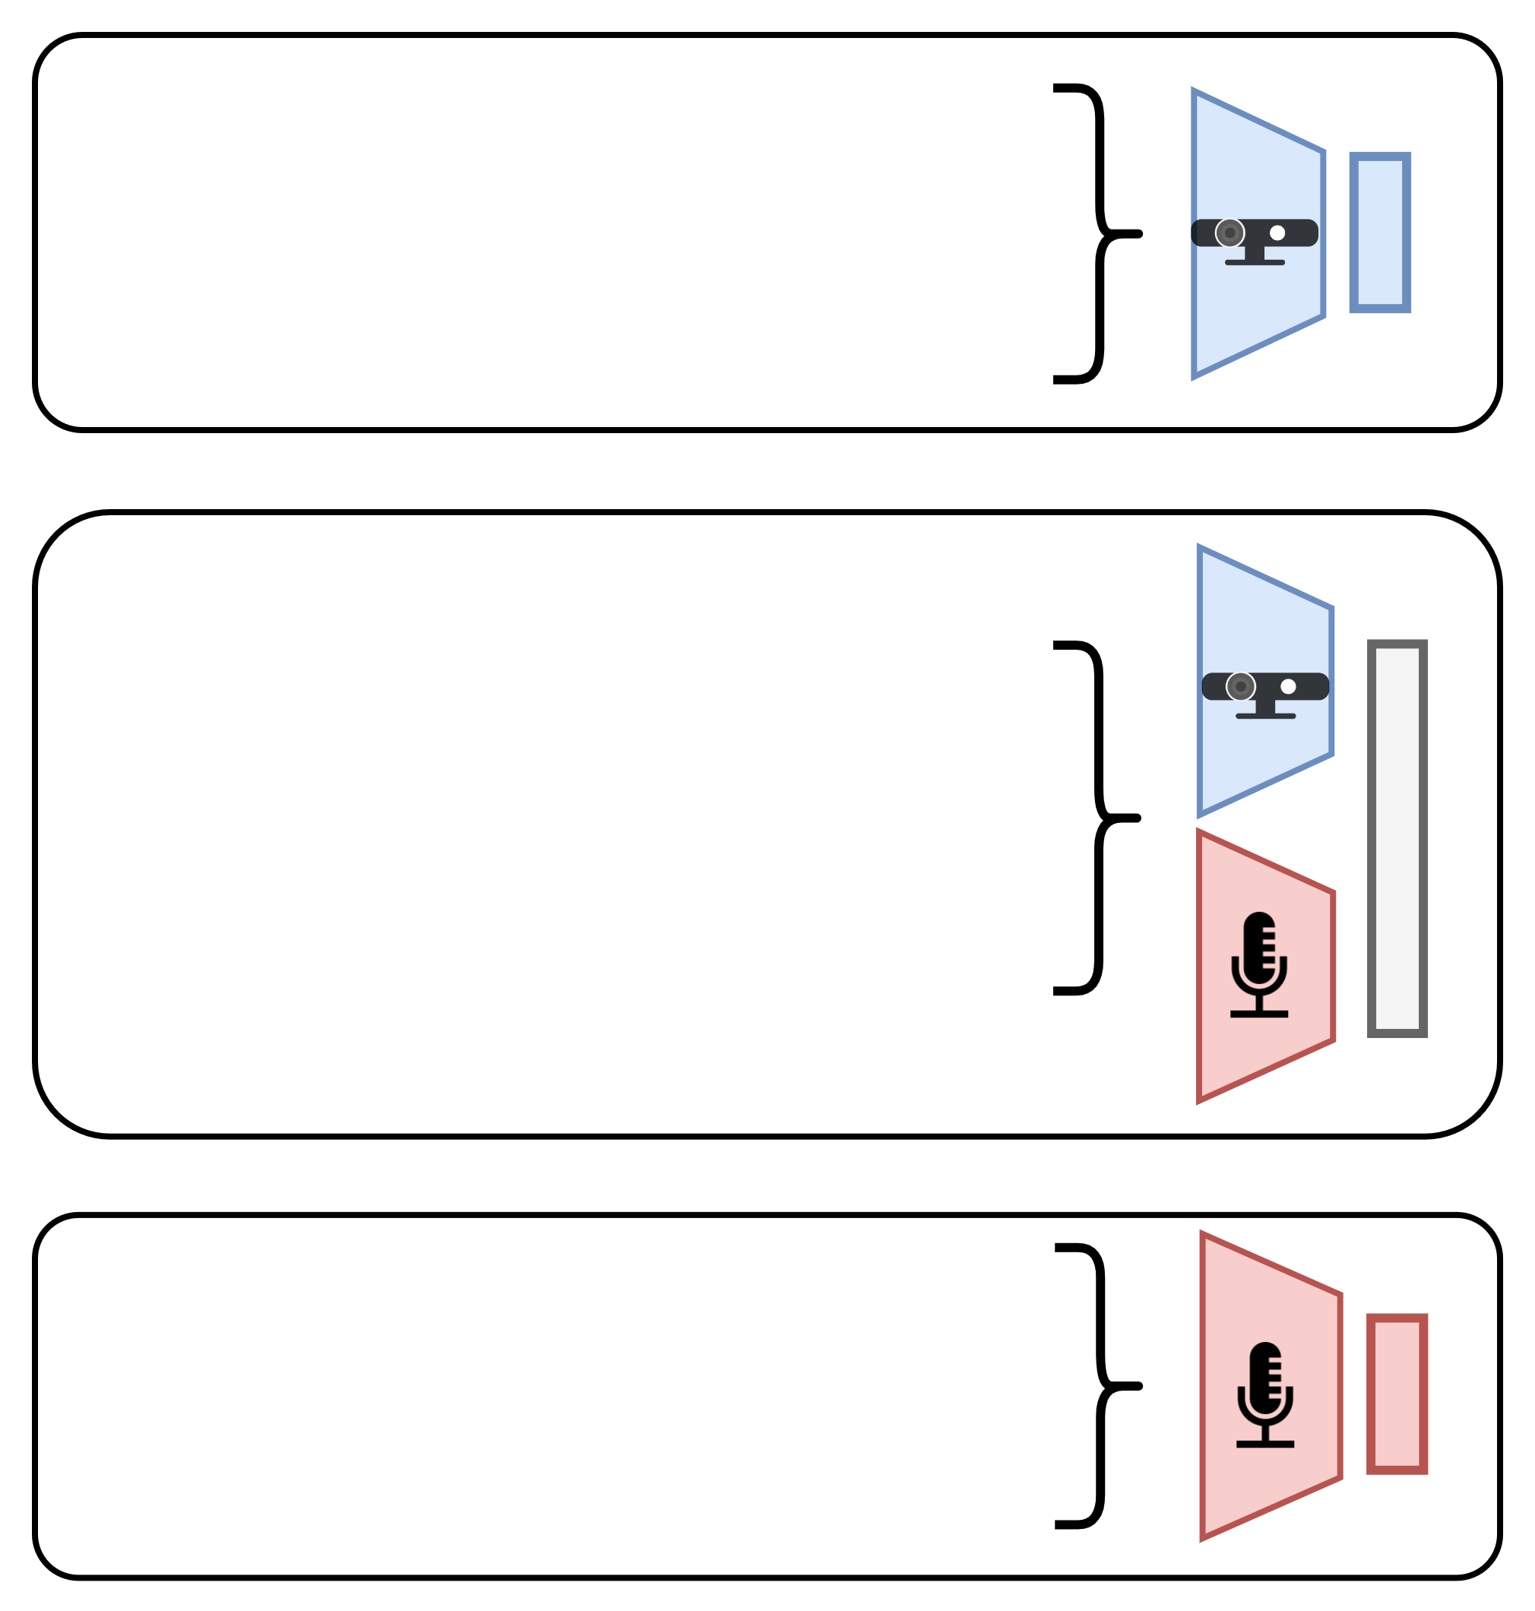
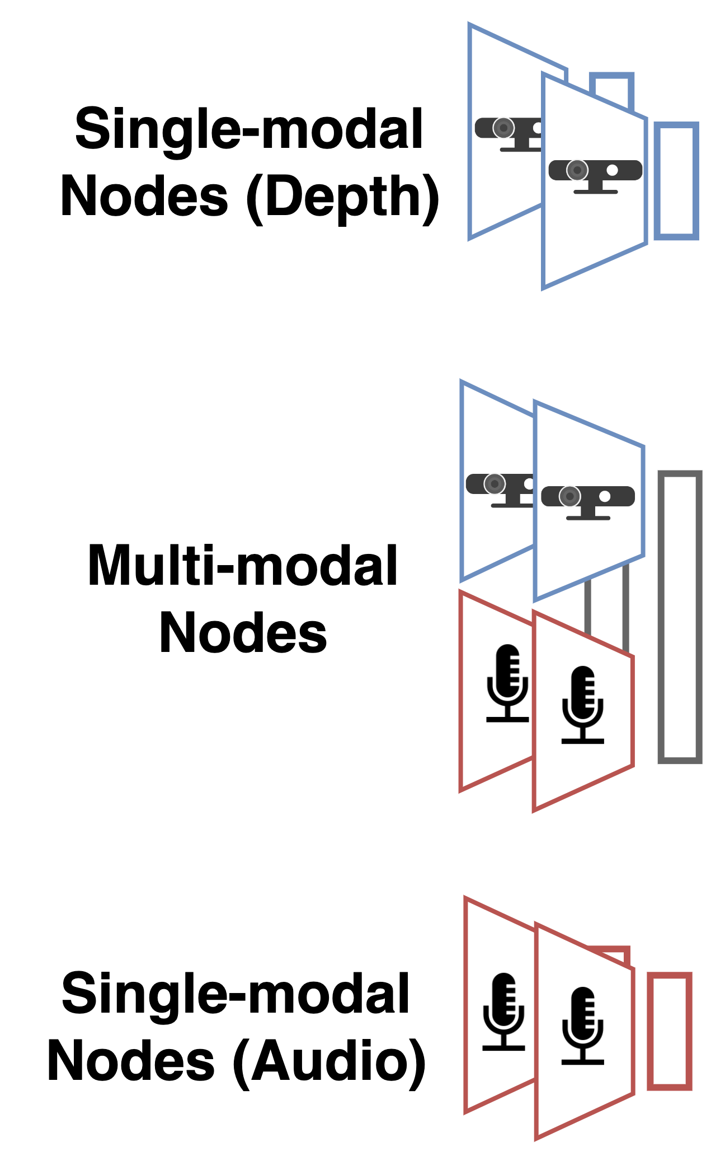
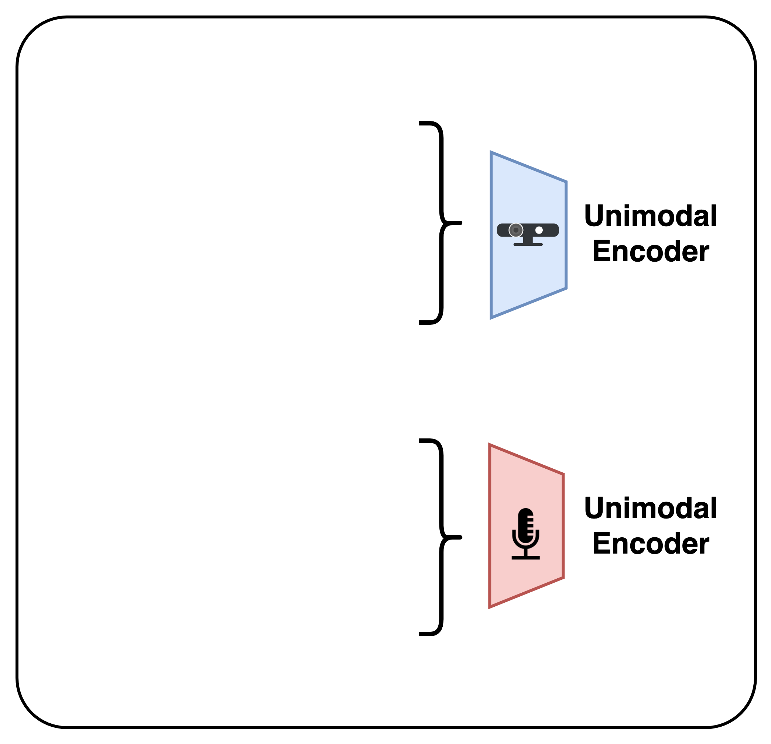
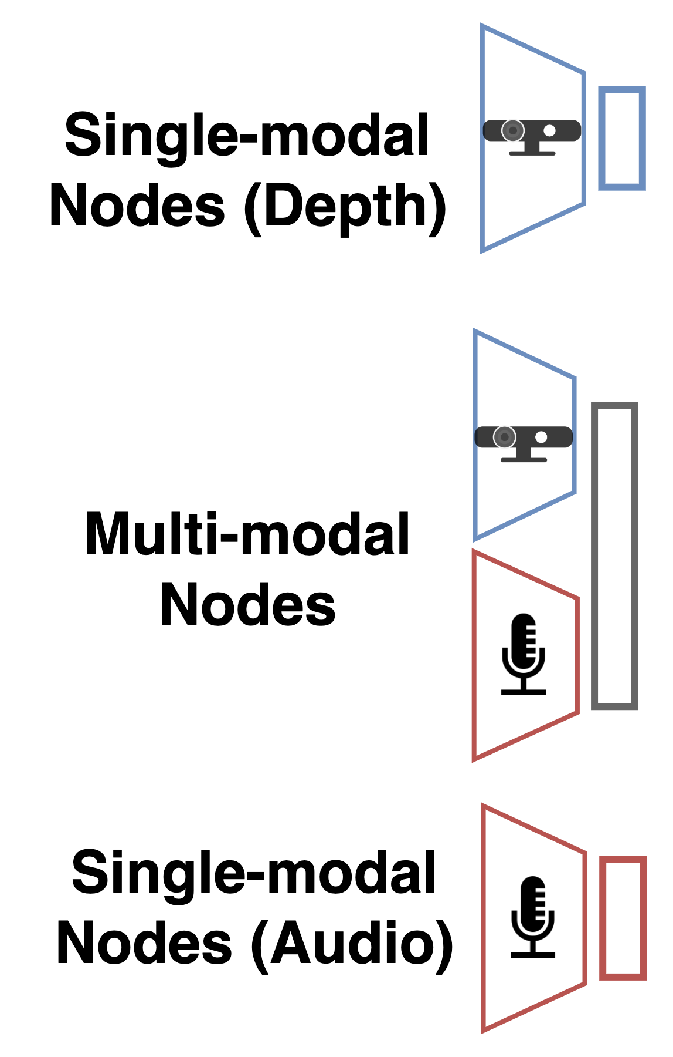
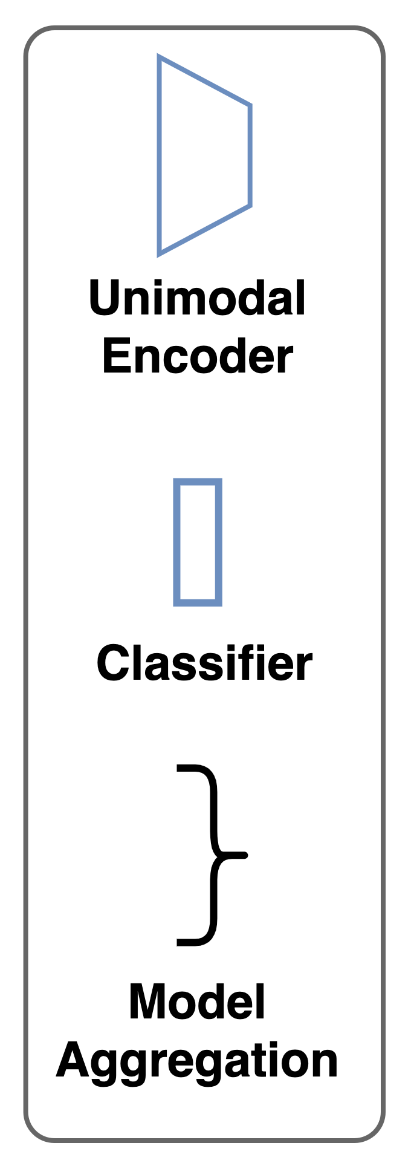
Current Solutions
Conventional FL
Multi-Modal FL
Among the same type of nodes
Among all nodes
Notes:
In current solutions, there are two typical FL frameworks that can work with multiple sensor modalities. The conventional approaches aggregate models with the same input of sensor modality. However, in this way, only a subset of nodes would learn from each other. When extending FL to multiple modalities, a natural approach is to aggregate the unimodal encoders of different types of nodes. In this example, the encoders of the depth and audio modalities would be aggregated separately. Compared with conventional approaches, this solution allows model aggregation among different types of nodes.
##apply conventional FL to the setting of multiple modalities, use audio and image, add encoder and classifier, aggregation
(change to 口語，不要那么多term)

Slide 6
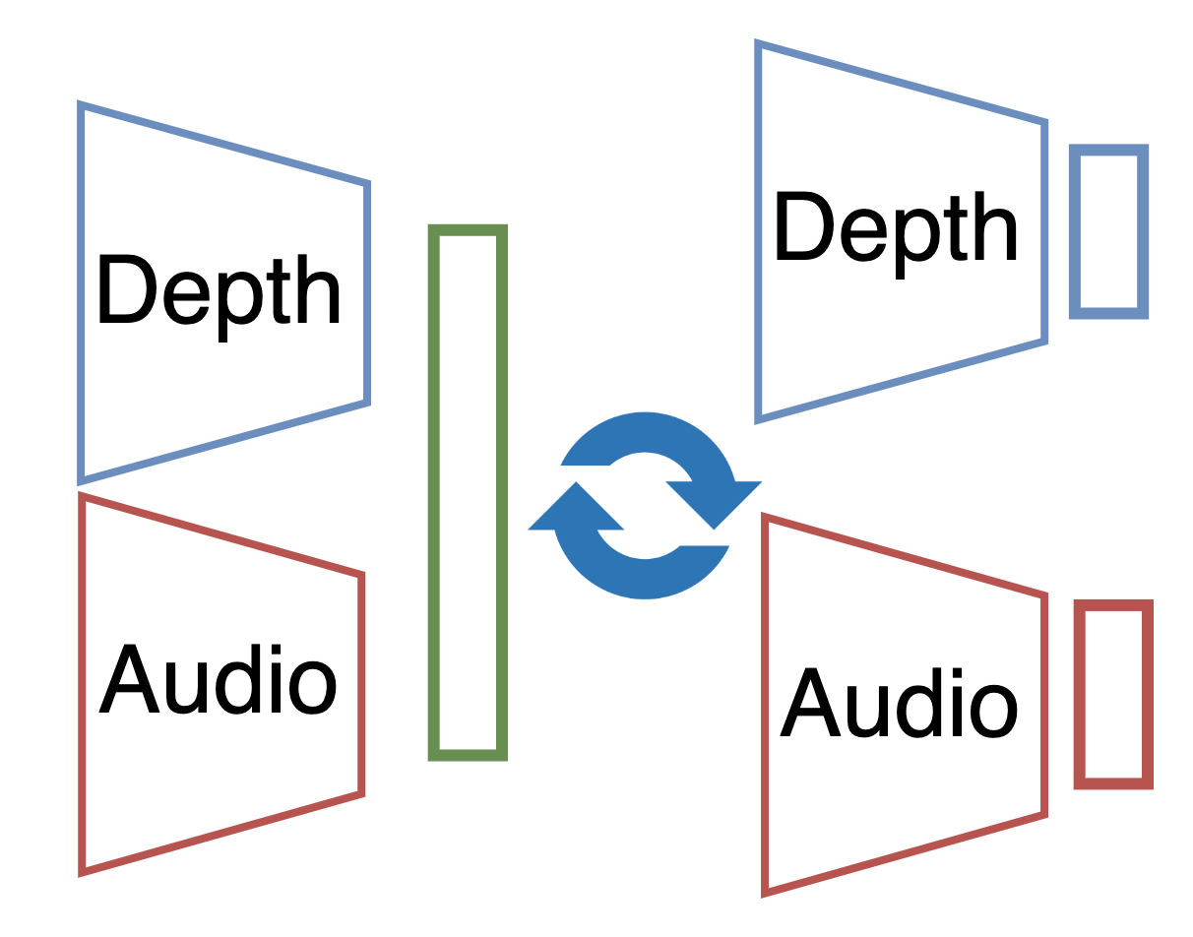
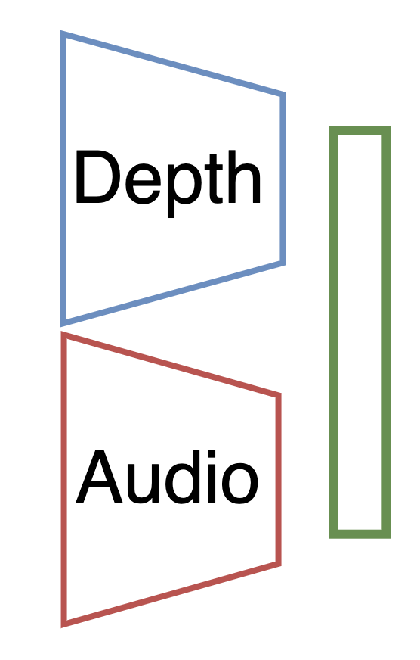
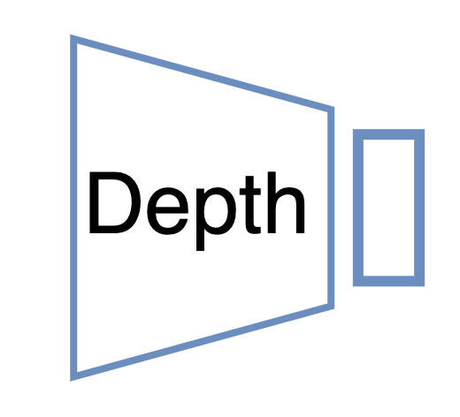

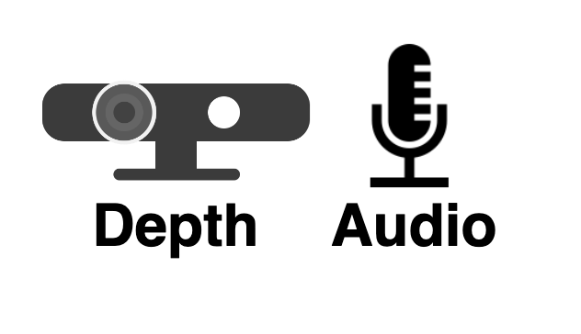
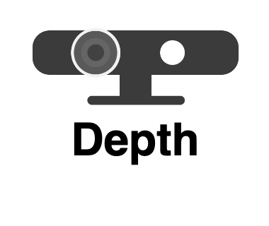


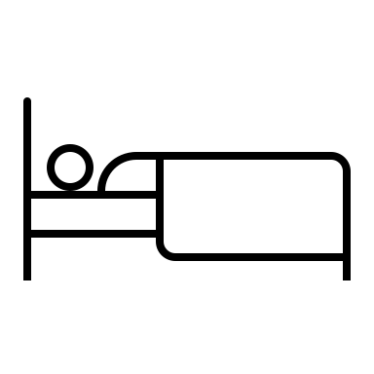




Multi-Modal FL System: Challenges
Modality heterogeneity
Higher model divergence
Server
Distribution heterogeneity
Longer training latency
Alzheimer’s patient monitoring
Notes:
However, such solutions have not addressed the challenges in real-world implementation of FL systems. Let’s take the application of Alzheimer’s patient monitoring as an example.
First, the sensor modalities available on different nodes can change significantly over time(after deployment). For example, the system deployed in different environments naturally have different types of sensors. The sensors may also fail dynamically due to reasons such as power surges. As a result, it would be challenging to aggregate different models with dynamic data inputs.
Second, different subjects usually exhibit diverse behavior patterns, which will lead to heterogeneous activity distributions among nodes.
The coupled modality and distribution heterogeneity will bring a higher model divergence among different nodes. As a result, there will be longer training latency in such systems.

Slide 7
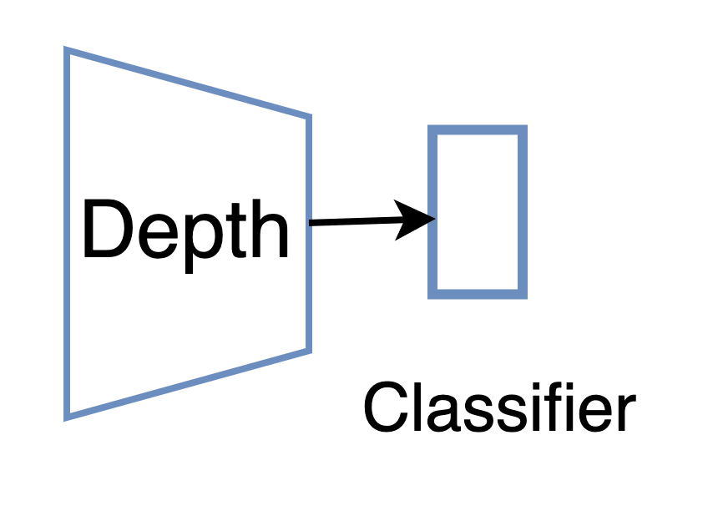
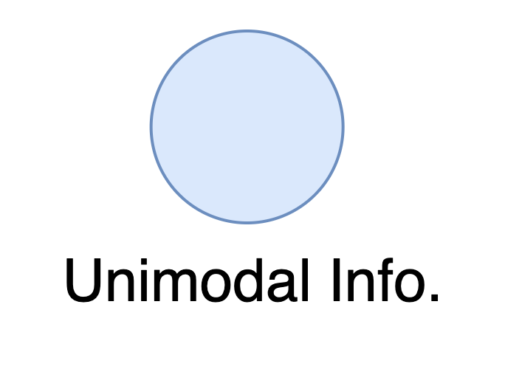
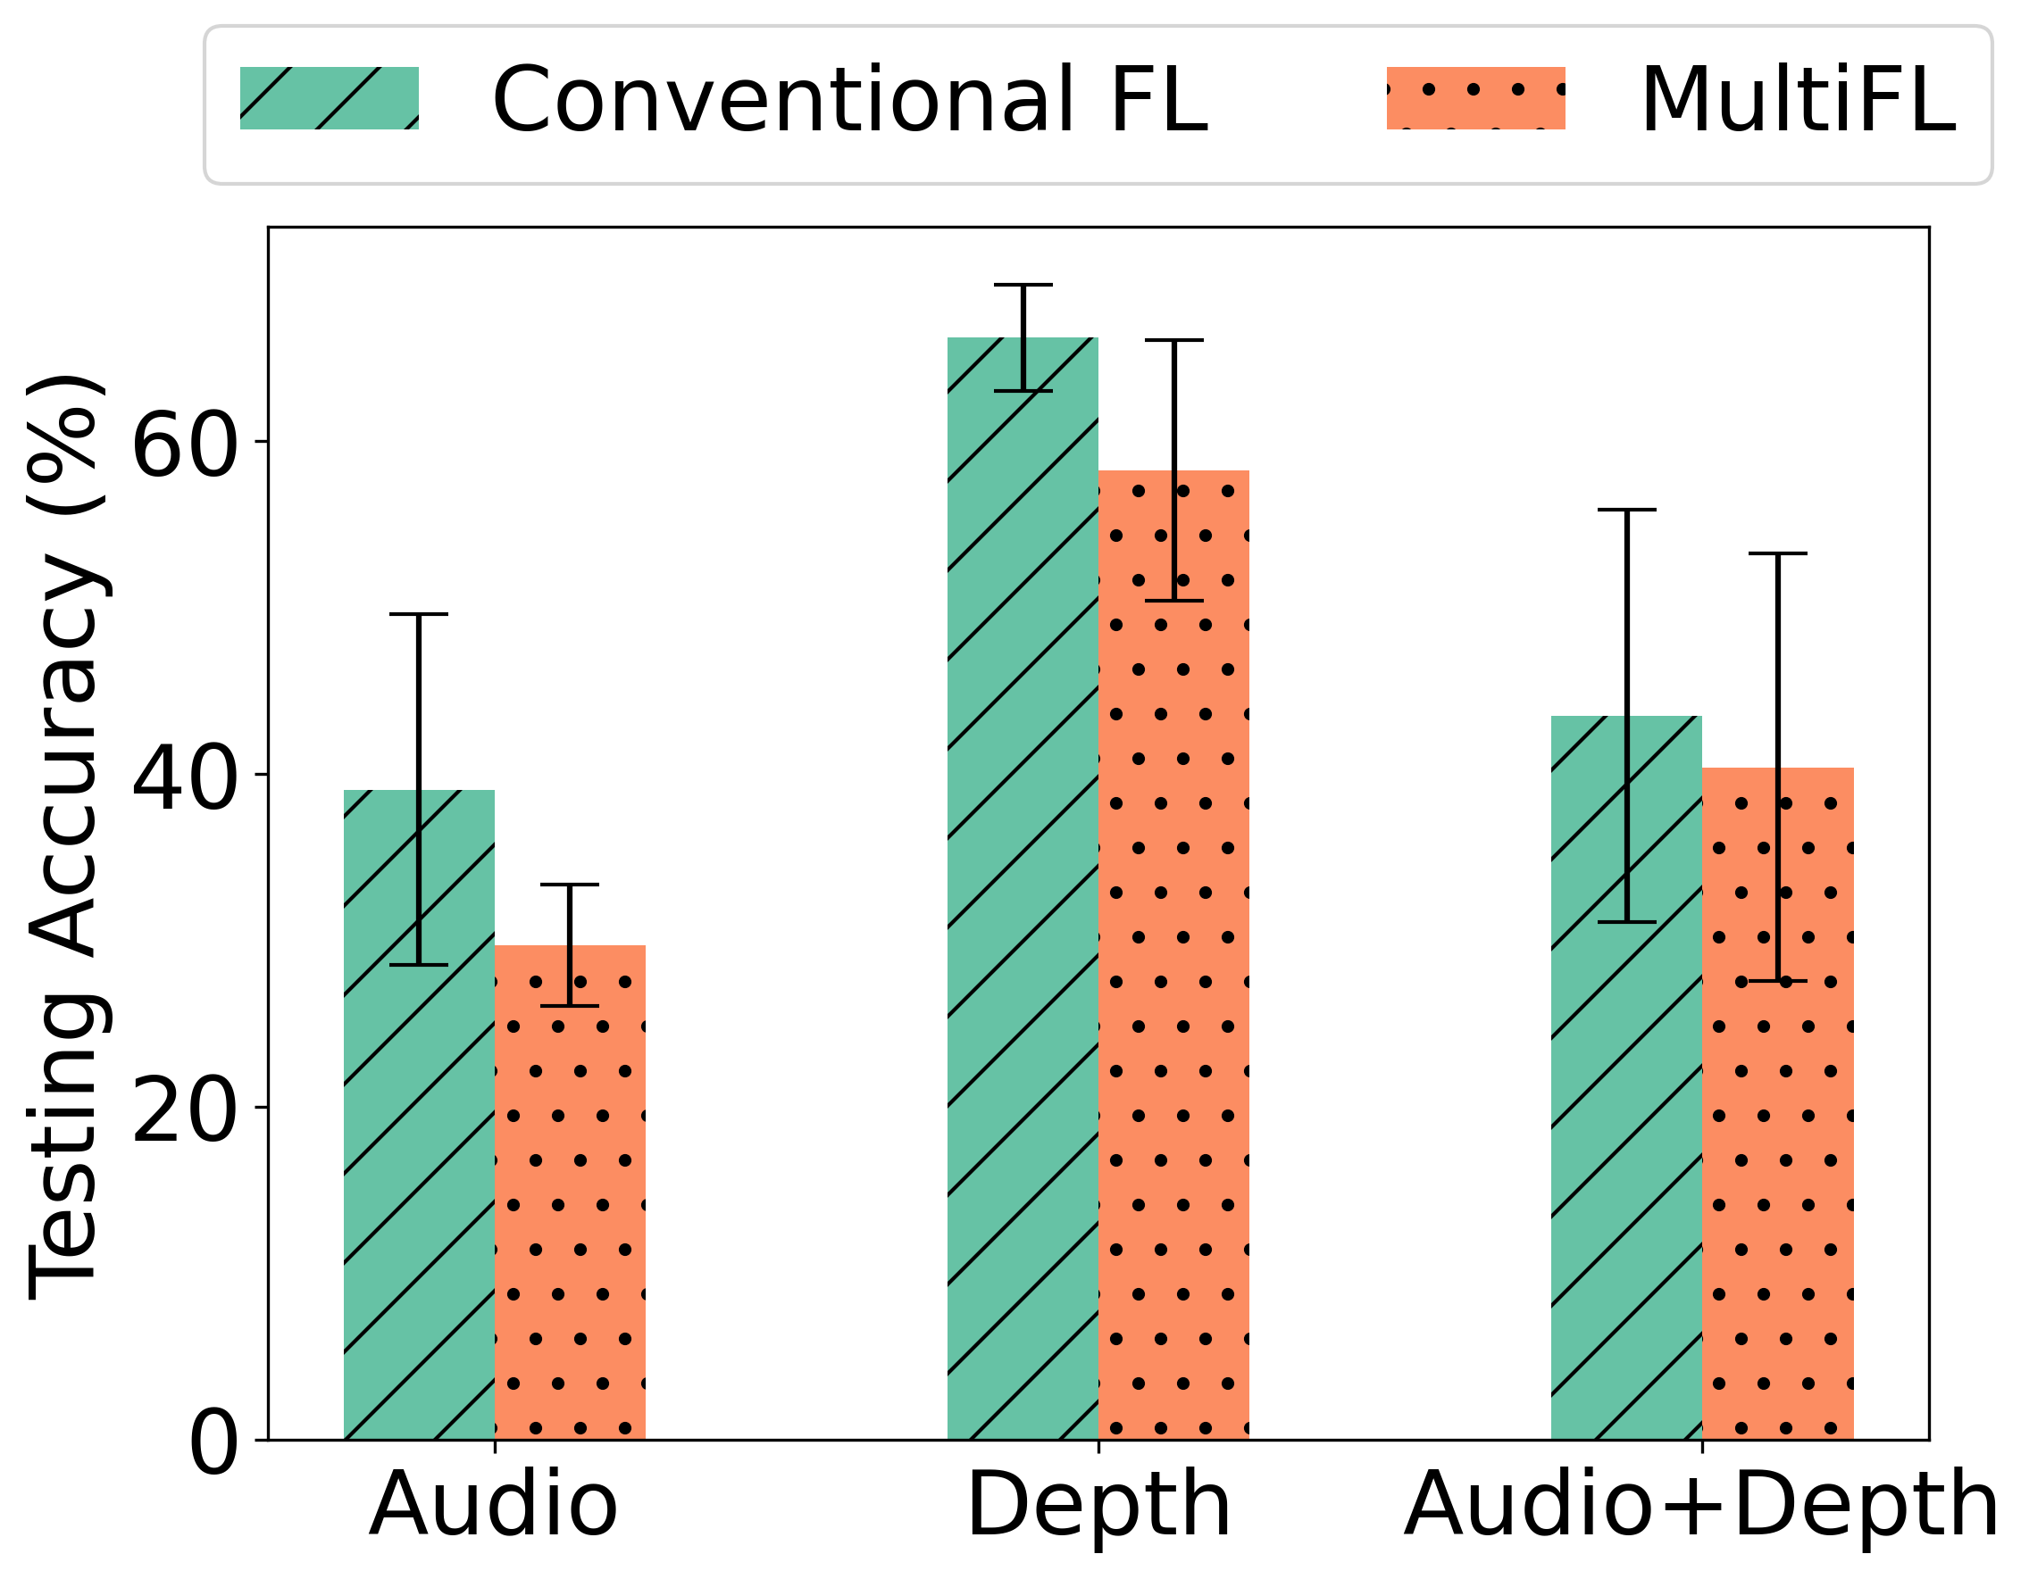
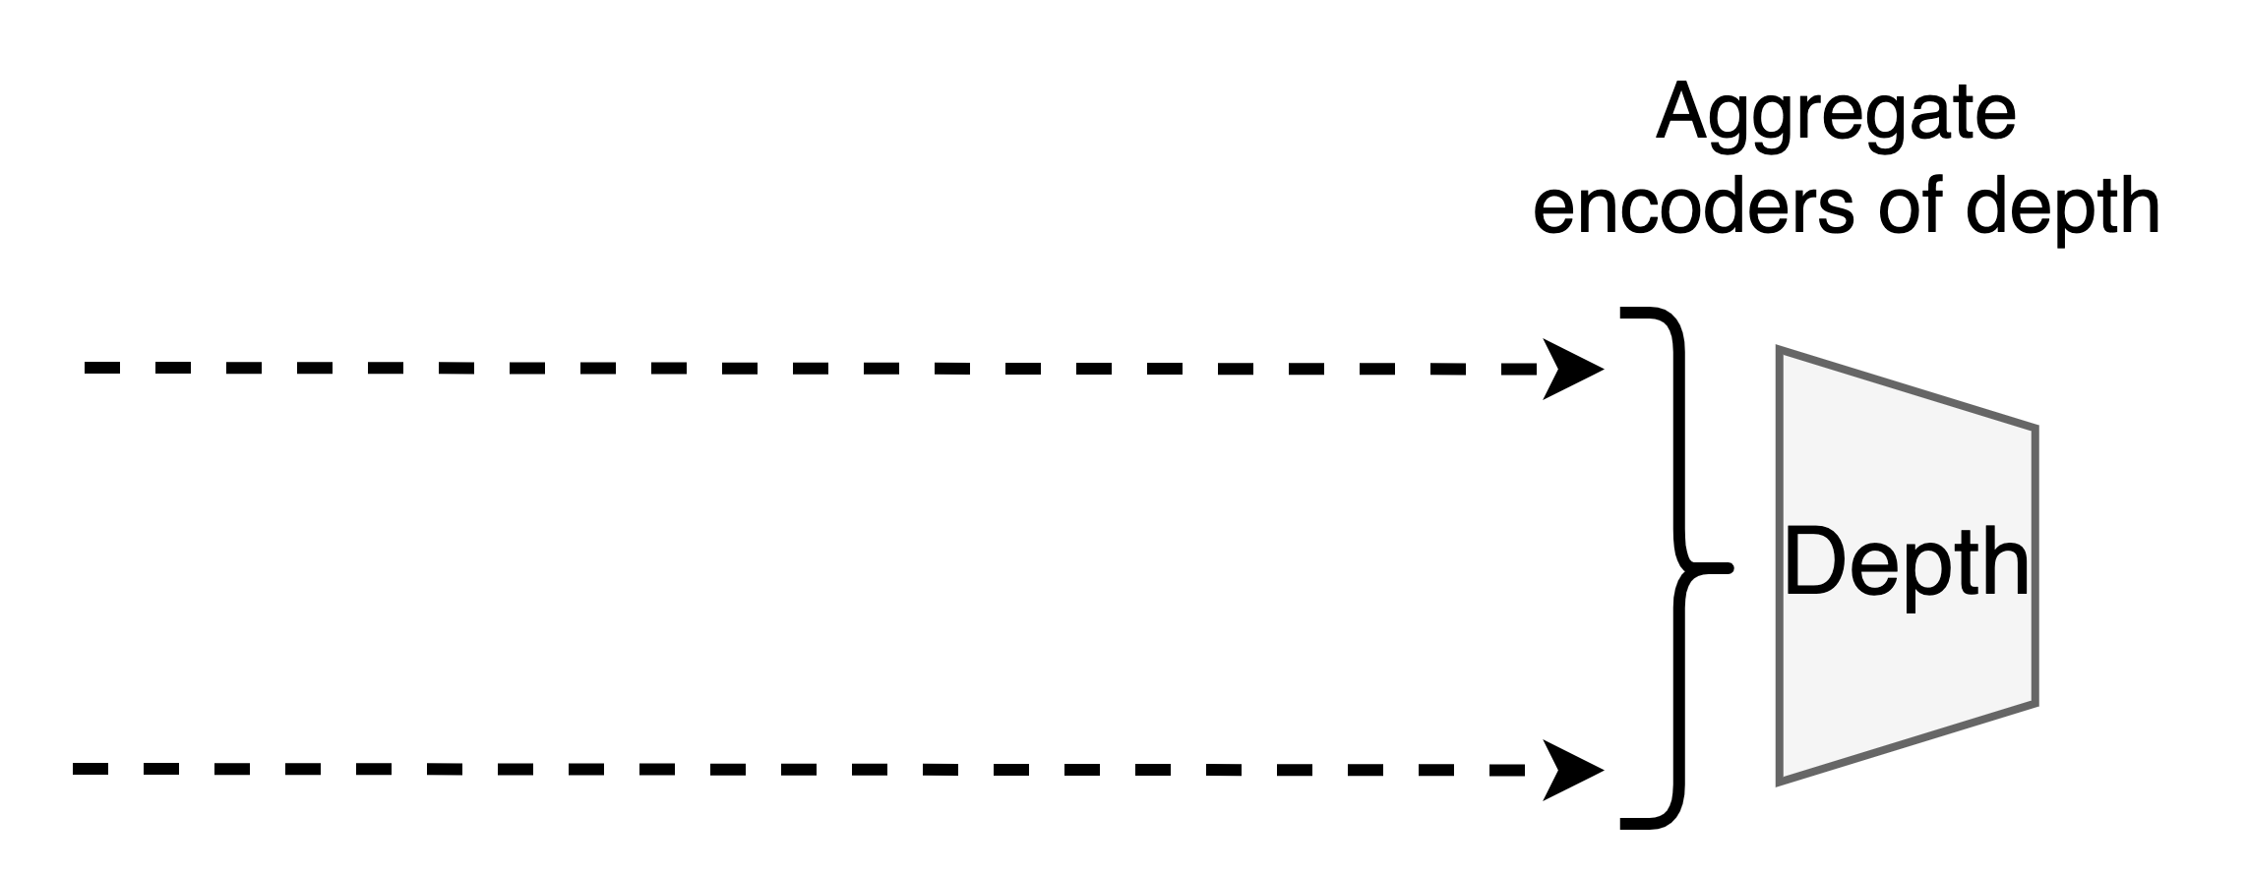
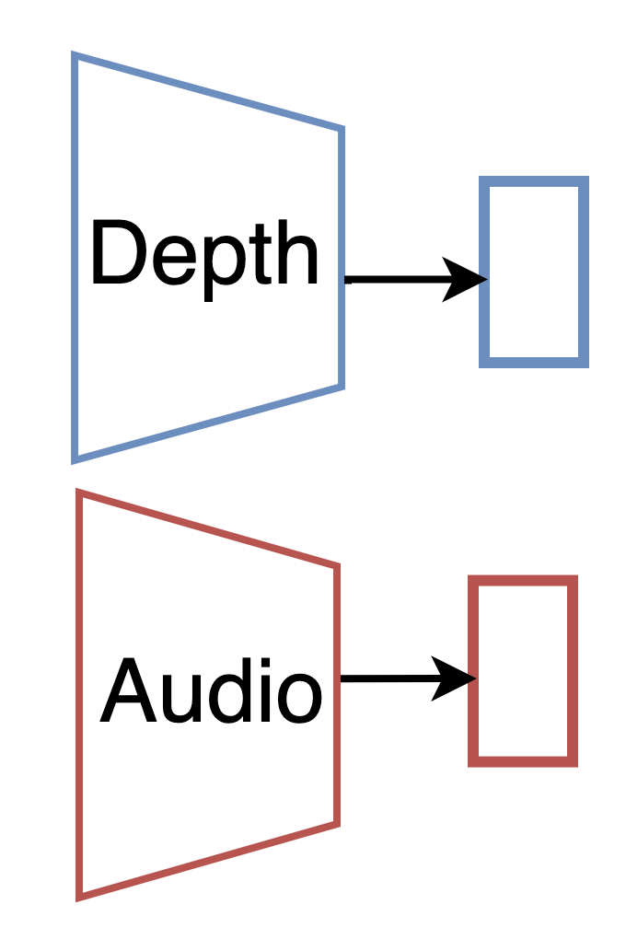
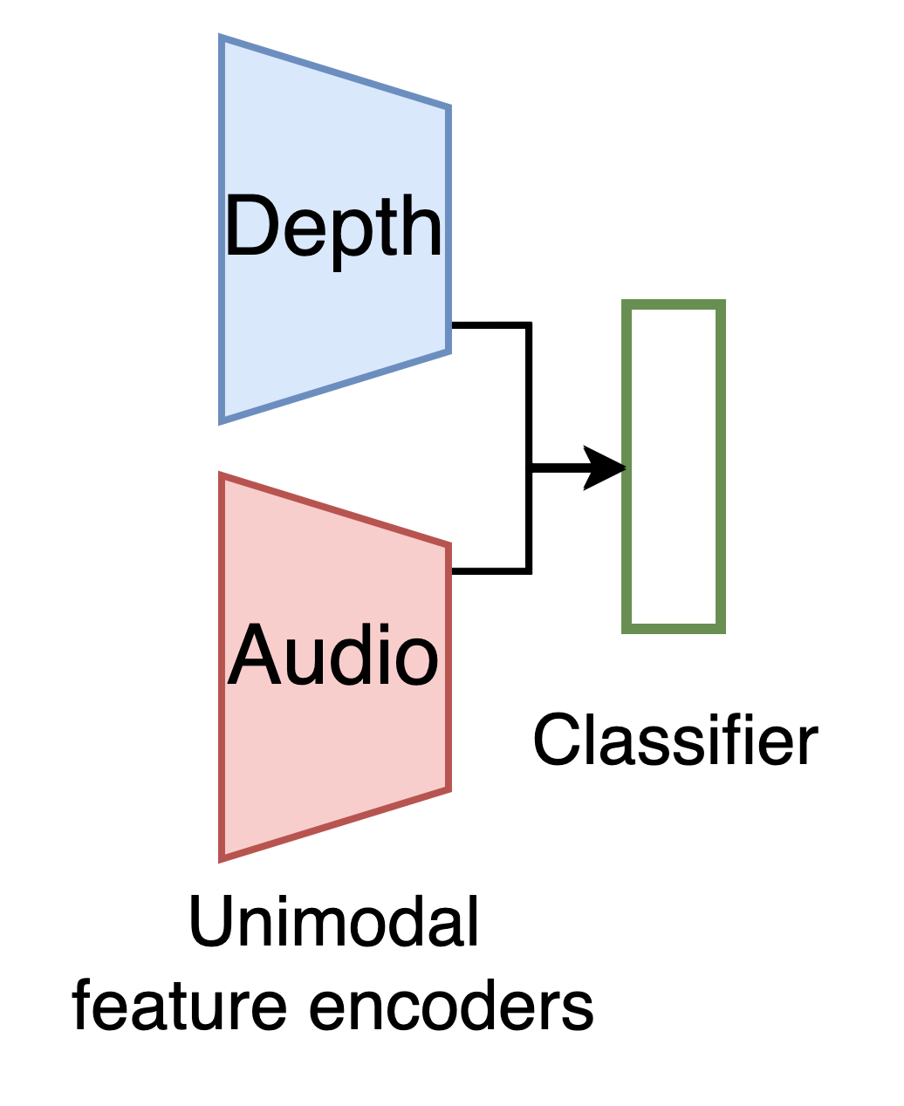
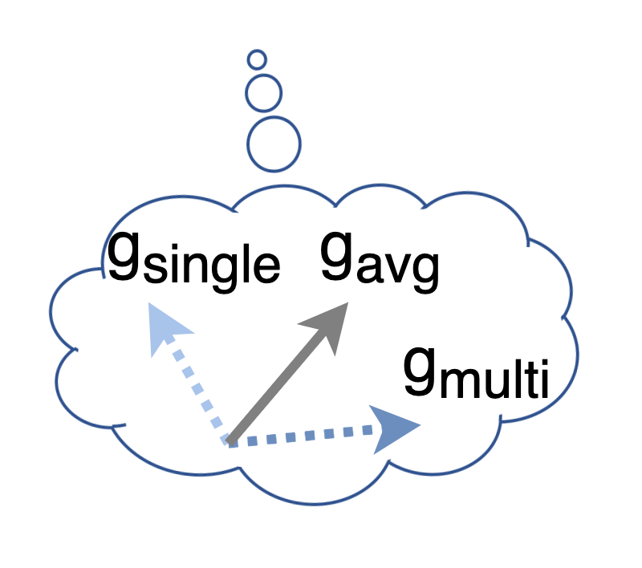
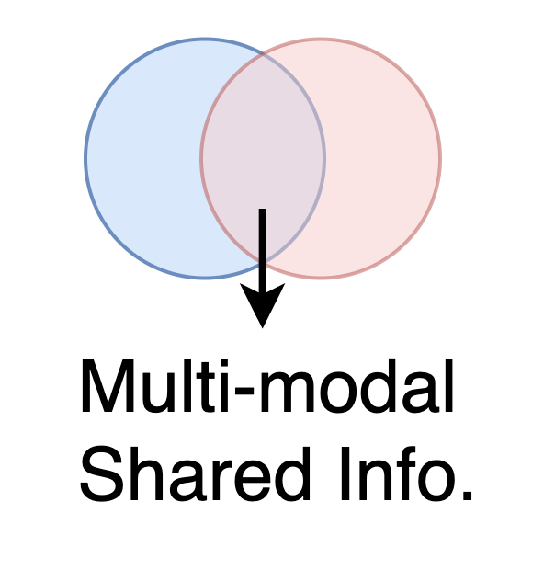
Understanding Multi-Modal FL Approaches
Inconsistent training objectives
Accuracy Drop
How about performing unimodal learning in multi-modal nodes?
Notes:
Now let's take a look at why current solutions cannot address these challenges. Basically, the training objectives of the models are different. However, current approaces does not consider this.
For example, the training objective of single-modal nodes is to capture unimodal information, while the multi-modal network is trained to capture shared information among different modalities, which will lose some useful unimodal information. Their model weights actually have a large divergence. As a result, directly aggregating the encoders from different nodes will cause model performance degradation, which is even worse than conventional FL.
Therefore, our key idea is to perform unimodal learning without modality fusion during such heterogeneous model aggregation.
##Now we focus on a specific challenge
##Specifically, current Multi-modal FL approaches do not consider the Inconsistent training objectives among different nodes.

Slide 8
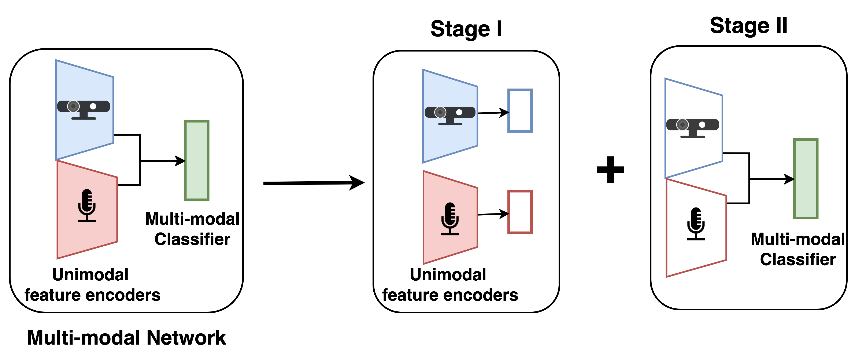
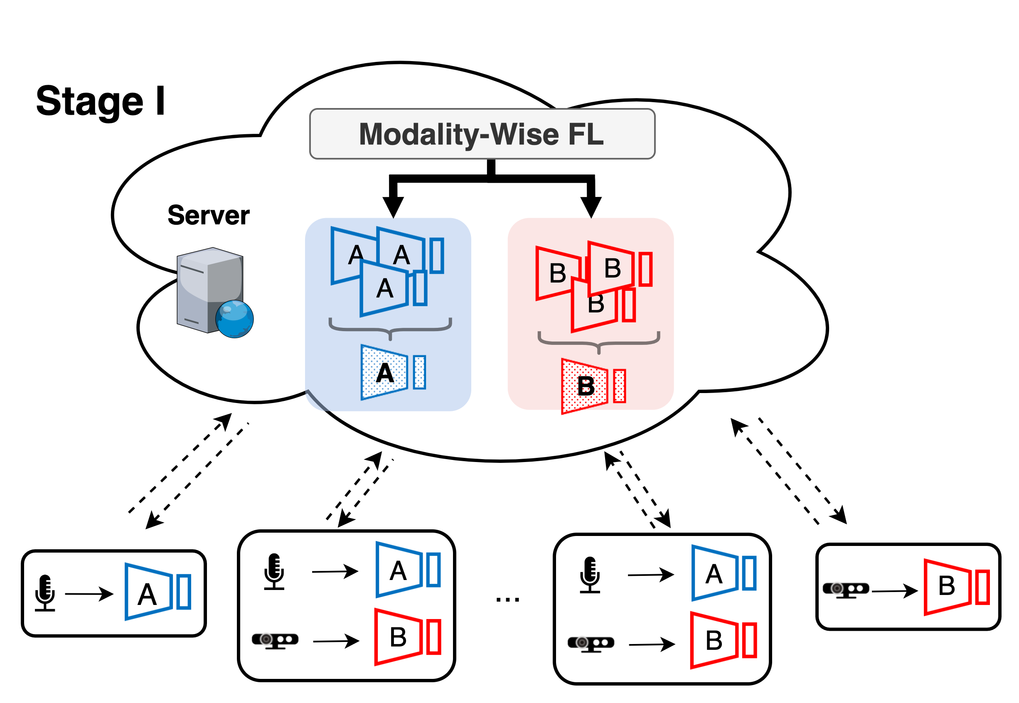
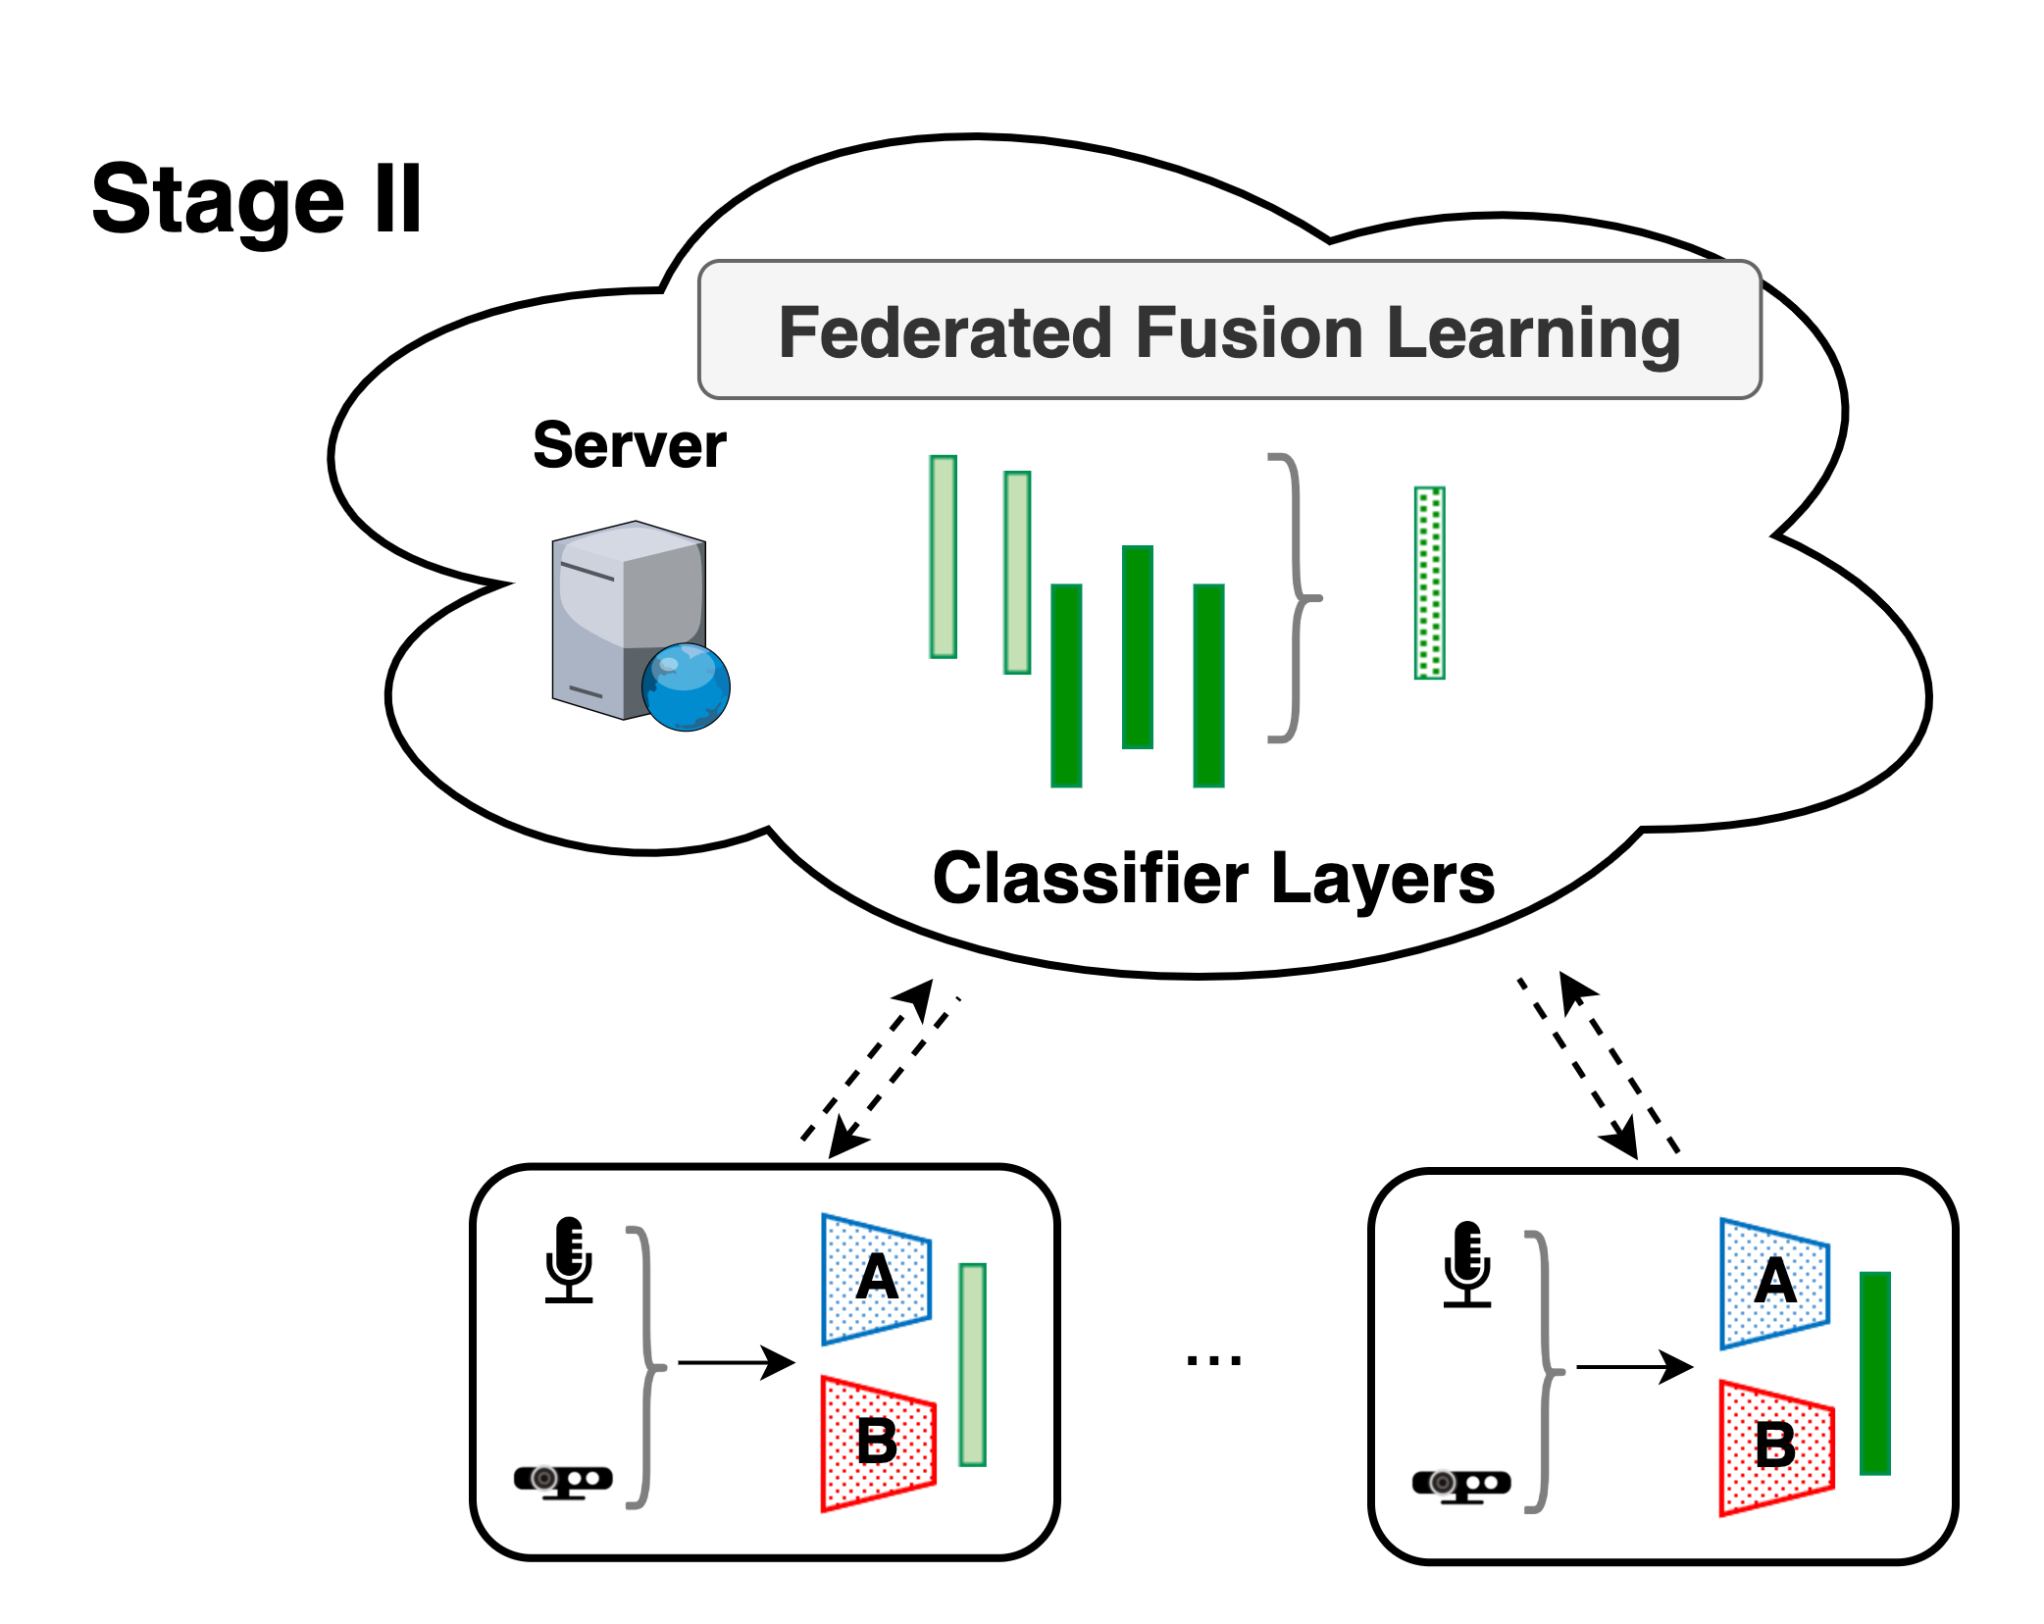
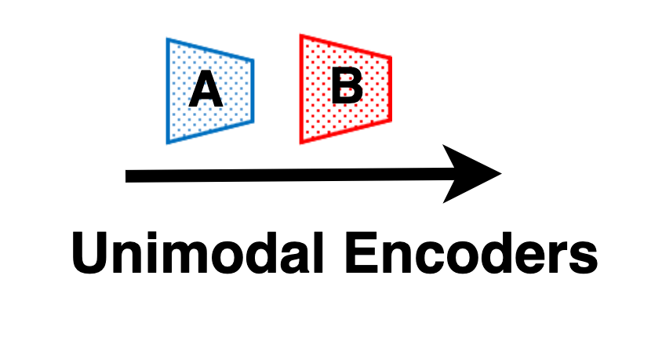
Harmony: Heterogeneous Multi-Modal Federated Learning
Key design: Disentangled Multi-Modal Training to Two Stages
Modality-Wise FL (Unimodal encoders)
Federated Fusion Learning (classifiers)
Notes:
To this end, we propose a new system for Heterogeneous Multi-Modal Federated Learning. ##to effectively aggregate models trained by data of different sensors.
Our key design is to disentangle the multi-modal training into two stages. Basically, a multi-modal network includes the unimodal feature encoders and a classifier. We propose to first train the unimodal encoders, and then train the classifier to fuse the features of different modalities.
Specifically, we propose a novel two-stage FL framework, including Modality-wise federated learning and federated fusion learning.
In the first stage, the multi-modal nodes train multiple single-modal networks without fusion. Therefore, all nodes consistently learn unimodal information to harness the modality heterogeneity.
Then based on the pre-trained unimodal encoders, in the second stage, the multi-modal nodes collaboratively train the classifier layers.
Next, we will introduce the design of the two stages, respectively.
标记出来classifier layers

Slide 9
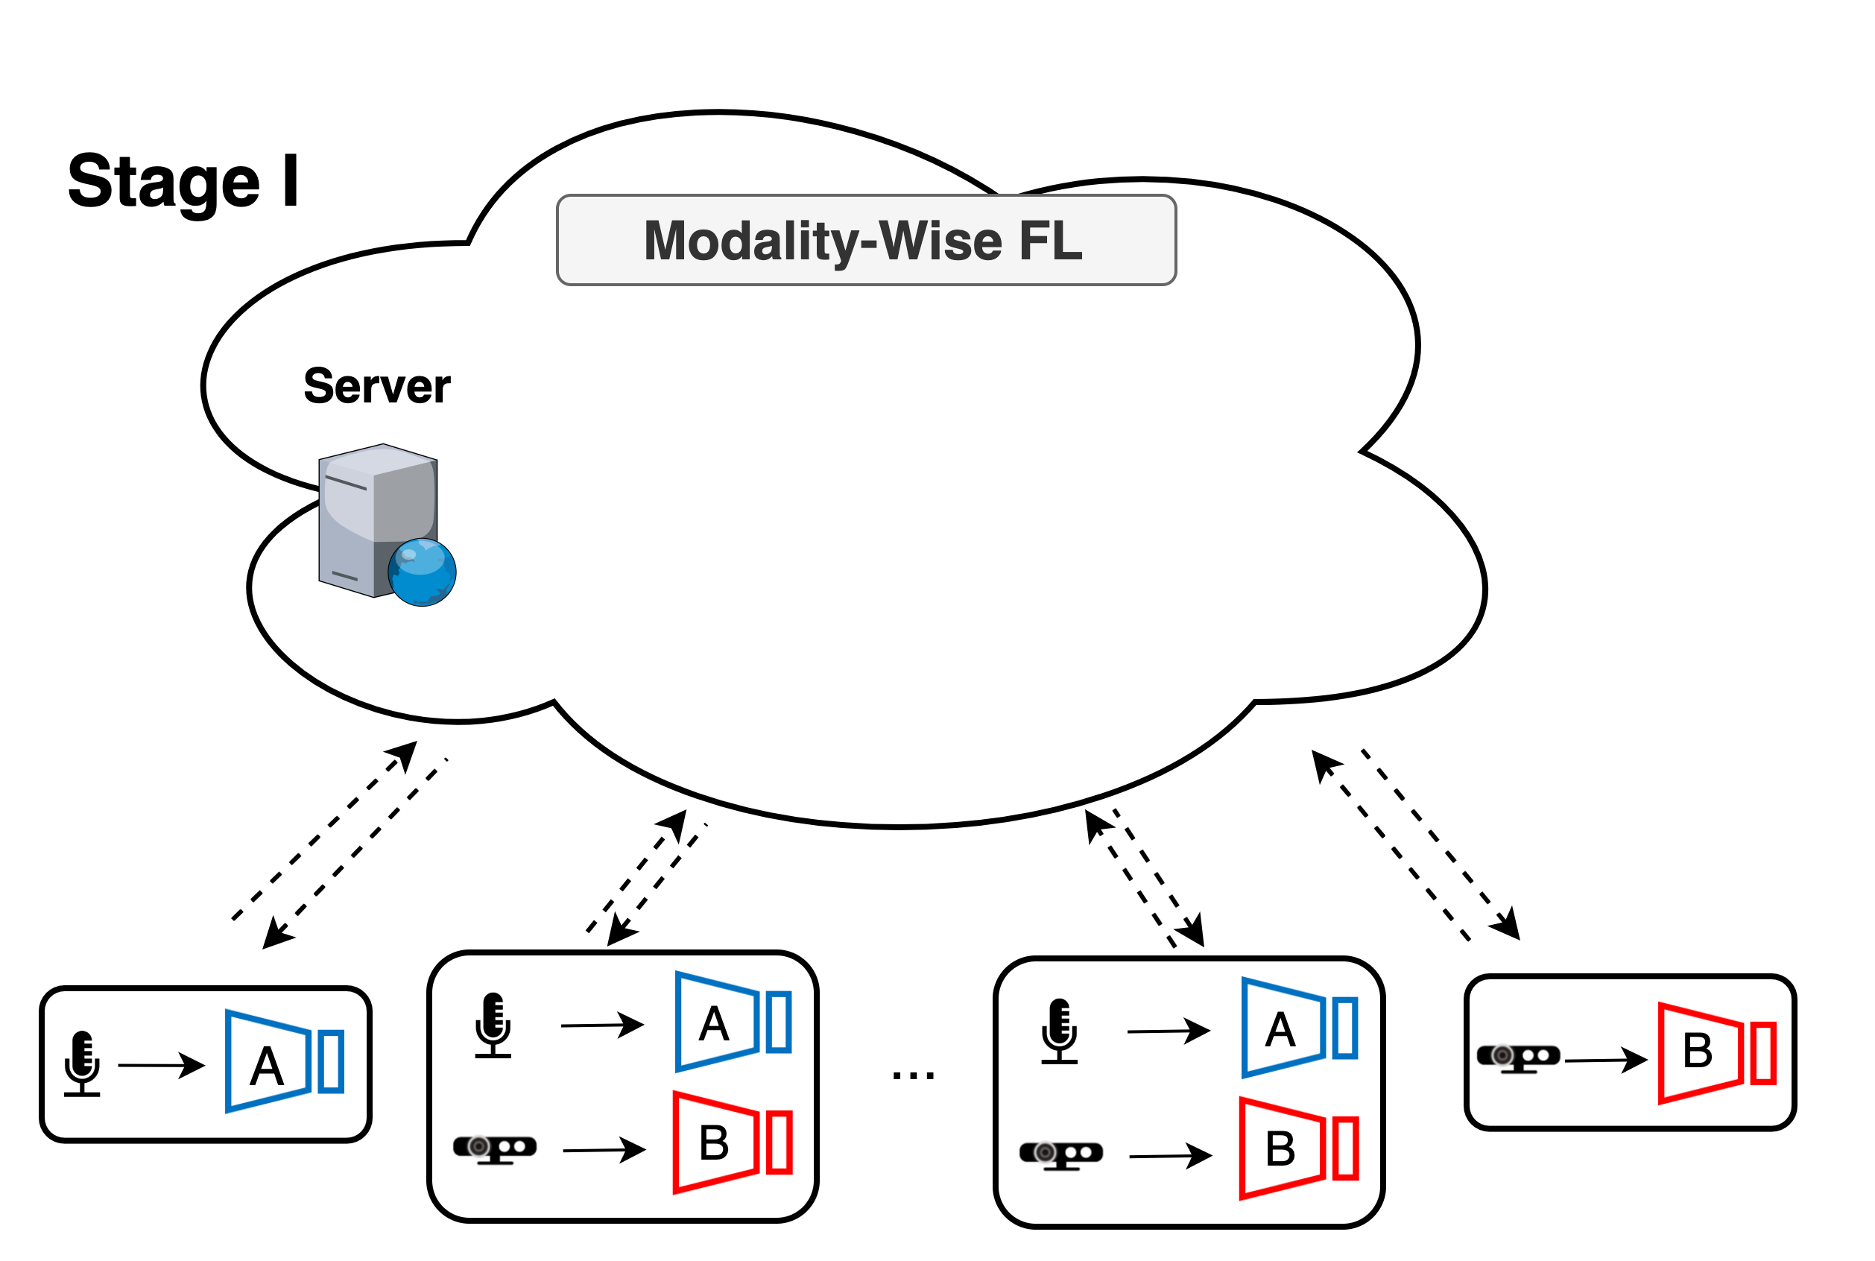
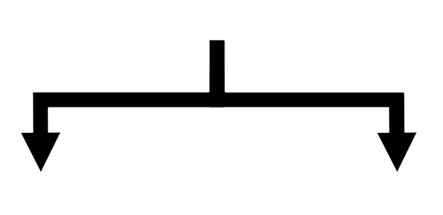
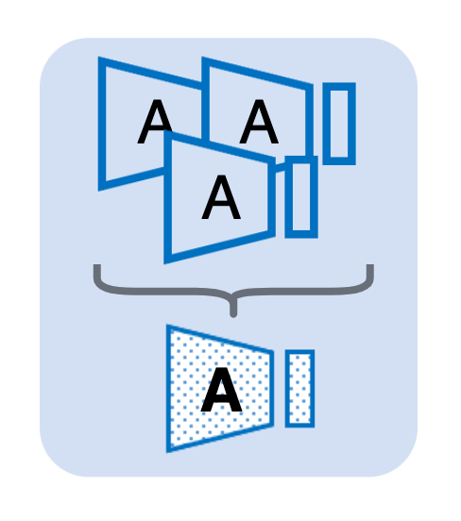
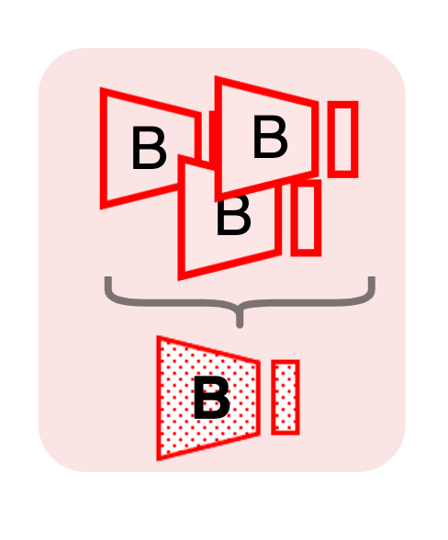
Modality-Wise Federated Learning
Local Training of Multi-Modal Nodes
Train multiple single-modal networks.
Leverage data of partial modalities.
Parallel Unimodal FL Subsystems
Naturally harness the modality heterogeneity.
Compatible with existing unimodal FL algorithms.
Notes:
In the first stage, during local training, the multi-modal nodes will train multiple single-modal networks. Therefore, they will capture unimodal information rather than shared information between different modalities. Another advantage of this design is that the multi-modal nodes can also leverage the data of partial modalities caused by runtime sensor failure.
Then, there will be multiple unimodal FL subsystems running in parallel. And all nodes consistently learn unimodal information. This will naturally harness the modality heterogeneity across nodes. Moreover, such a scheme is also compatible with state-of-the-art unimodal FL algorithms, e.g., it can further improve the model performance in the presence of non-i.i.d. data distribution.

Slide 10
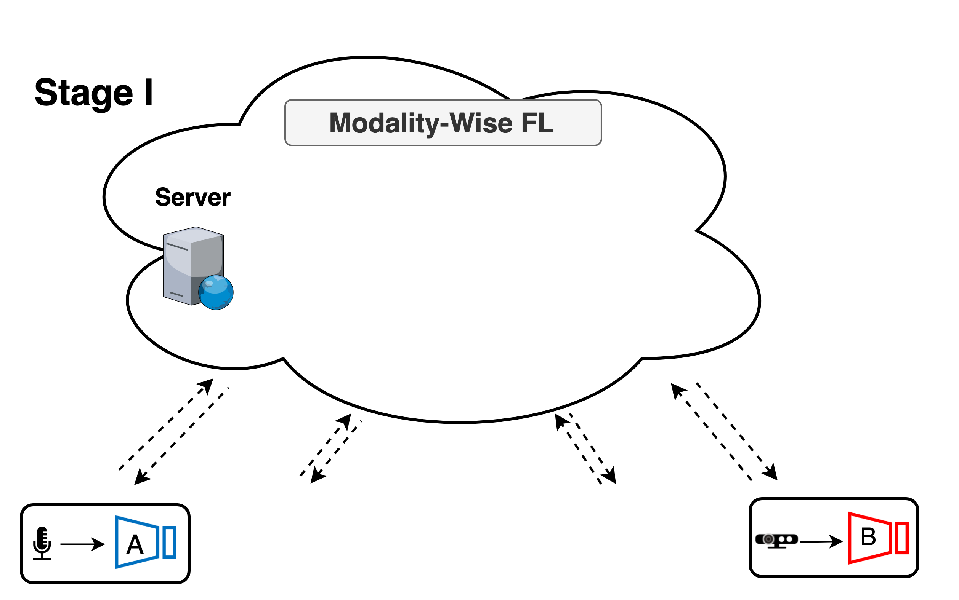
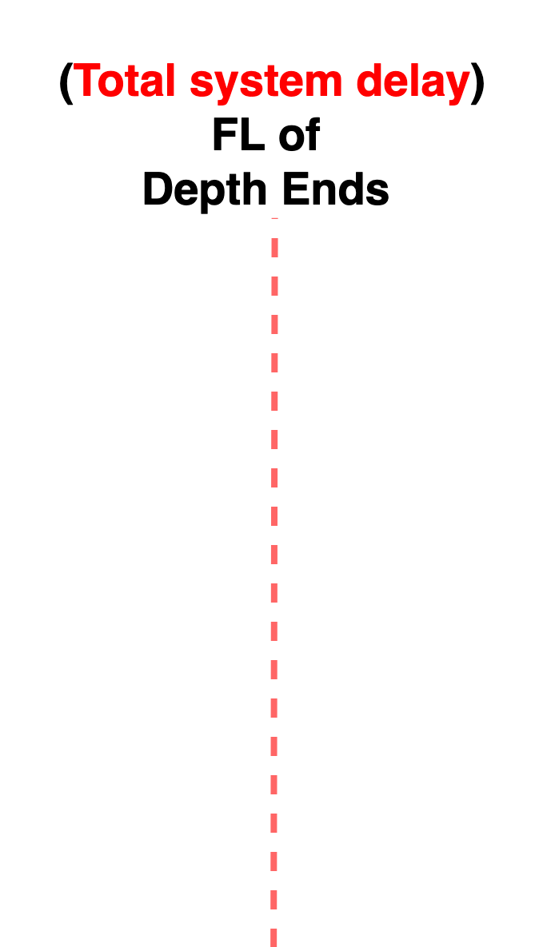
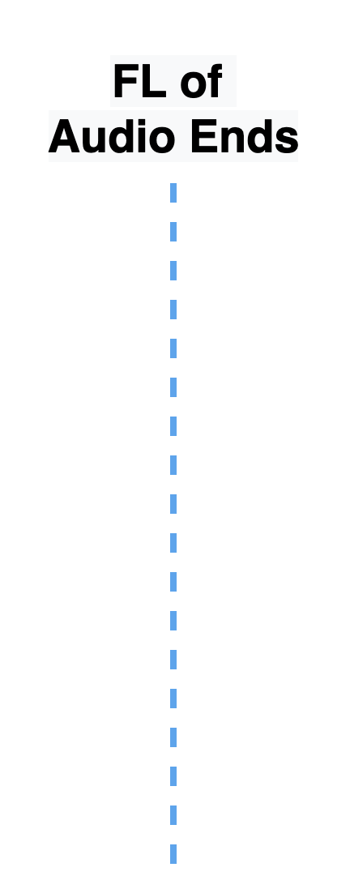
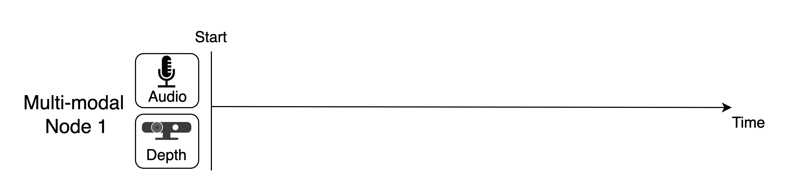
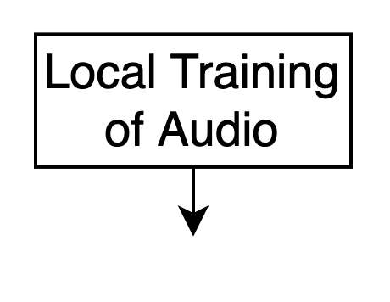
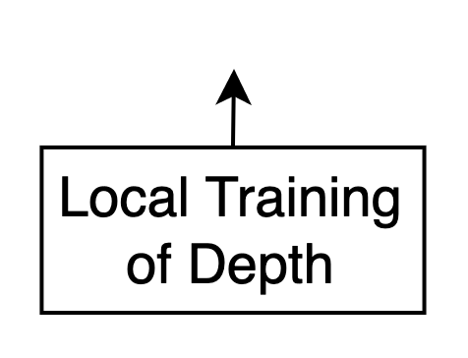
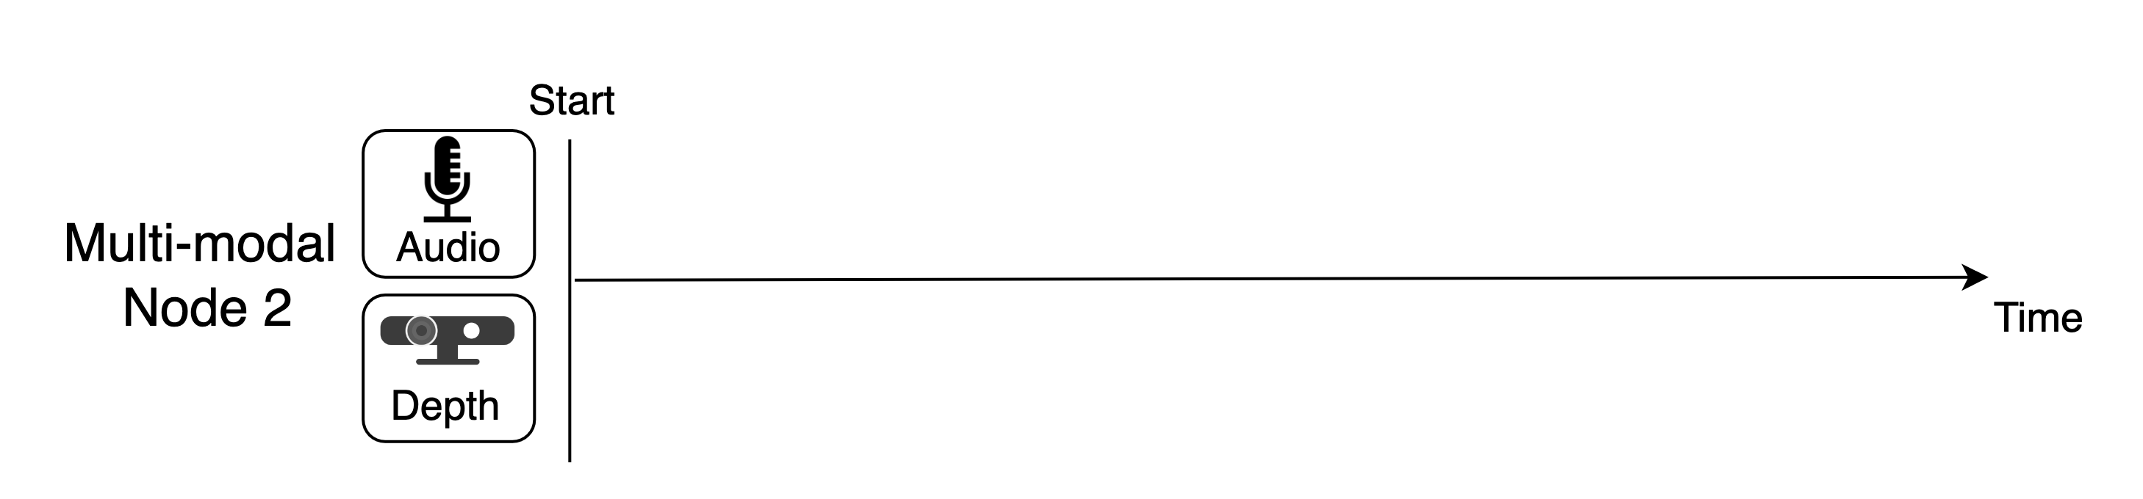
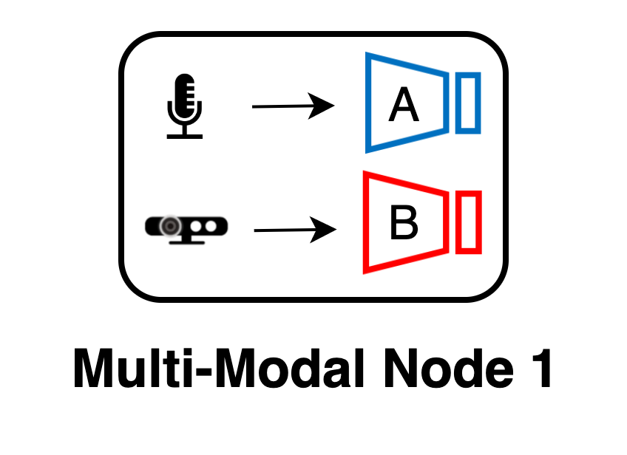

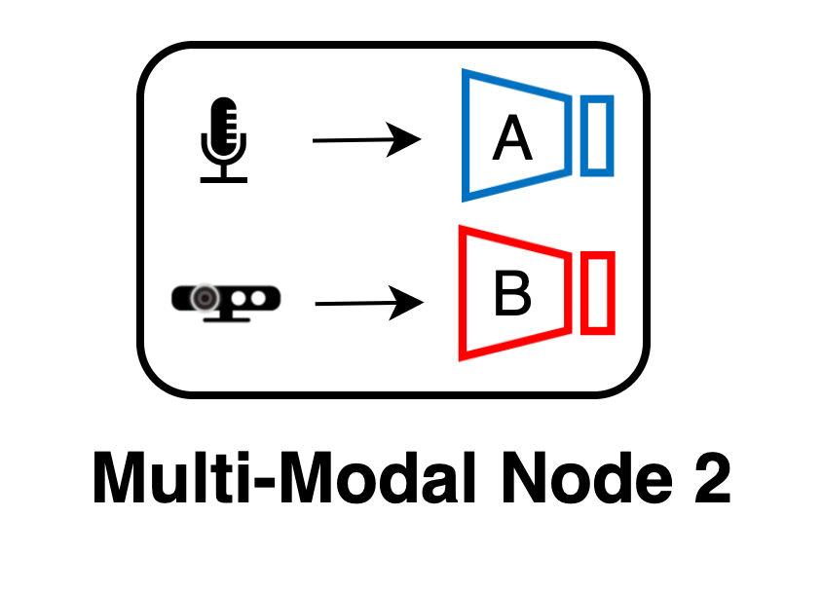
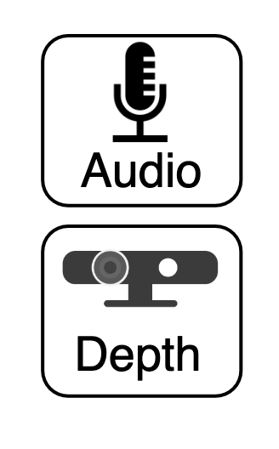

Modality-Wise Federated Learning
Imbalanced Training Delays
Balance-Aware Resource Allocation
Less resources
More resources
Notes:
However, there will be imbalanced training delays among different modalities.
For example, the multi-modal nodes will run two processes for single-modal training of audio and depth data. Due to different model architectures and input data dimensions, the processes of the two modalities take different amounts of time.
Moreover, the training delays of different nodes can also change significantly due to diverse resource availabilities. As a result, the unimodal FL systems of audio and depth will also have imbalanced training latencies. The convergence of the whole system depends on the slowest modalities, which prolongs the overall system training latency.
Our key observation is that, in our framework, the multi-modal nodes can actually coordinate the convergence of different unimodal FL subsystems. Therefore, we propose a balance-aware resource allocation scheme, where the multi-modal nodes can dynamically allocate more resources to the slower single-modal learning task.
Finally, the training delays of different unimodal FL subsystems will be more balanced, thus reducing the overall system latency.
###Compute resources, delete CPU/GPU, 标记audio training and depth training (或者直接标记 more resources and less resources)

Slide 11
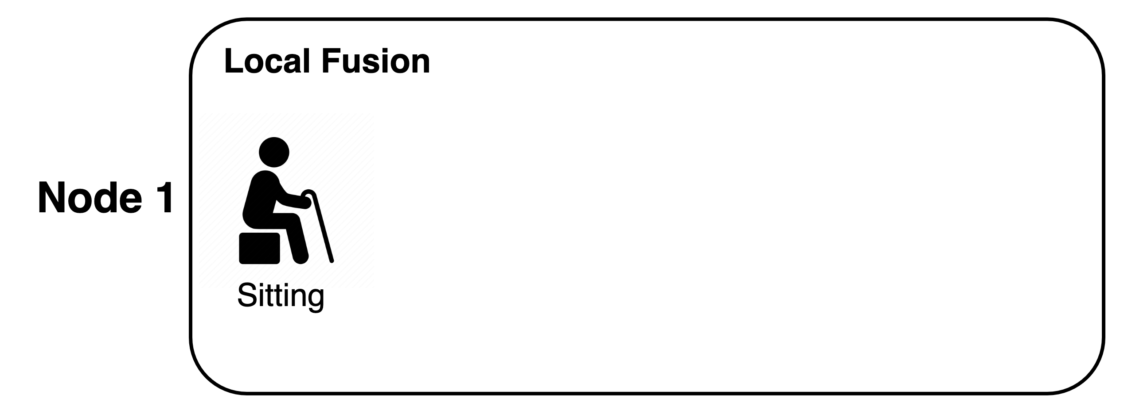
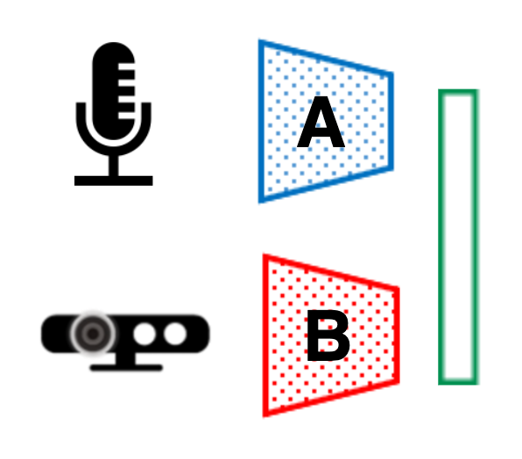
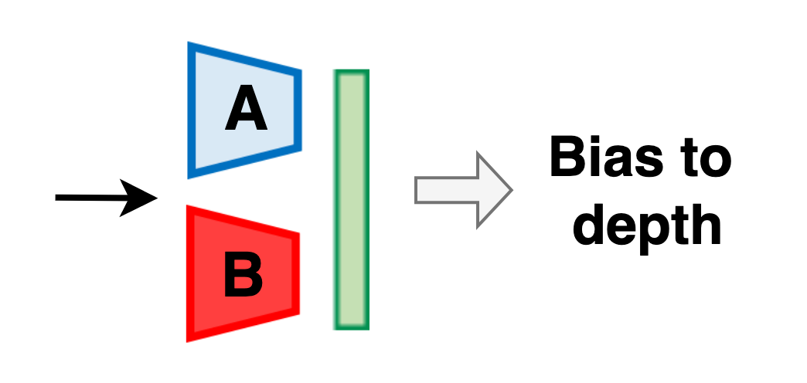
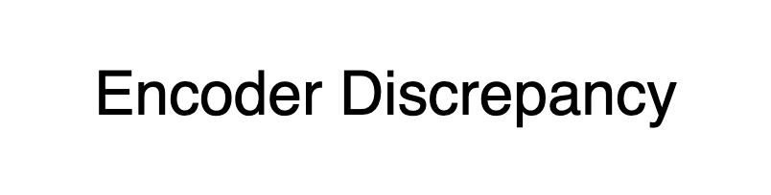


Federated Fusion Learning
Train the Classifier Layers
Challenge: Non-i.i.d. data distributions.
Modality bias of multi-modal networks.
Classifier layers
Opportunity: Exploit the Modality Bias
Benchmark: the pre-trained feature encoders.
Measuring modality bias via encoder discrepancy.
Classifier layers
Notes:
Then in the second stage, the multi-modal nodes collaboratively train the classifier layers, which fused the feature generated by different unimodal encoders.
A major challenge is that the nodes have non-i.i.d data distribution. As a result, the multi-modal networks of different nodes may show substantial bias toward different modalities. For example, in Alzheimer’s patient monitoring, the AD subjects usually spend lots of time in the activity of "sitting", so that their models may bias to depth images that captures the subjects’ postures. However, cognitively normal subjects will more likely interact with others. Therefore, their model accuracy may depend on the audio data that captures human voices. Then directly aggregating the classifiers of different nodes will cause performance degradation.
However, on the other hand, it also provides an opportunity to exploit such modality bias for addressing the data non-i.i.d problem. Because, in this stage, the feature encoders of all nodes are initialized with model weights pre-trained in the first stage, which serves as a benchmark. Therefore, the discrepancy of unimodal encoders during local fusion essentially reflects the modality biases of different nodes.
Then the server will leverage the modality bias of nodes to aggregate their classifiers, but we skips the details here.
##And we can quantify the modality biases of the nodes by calculating the cosine distance between the current feature encoders and the initial benchmark encoders.

Slide 12
Real-World Testbed Evaluation
Multi-Modal Sensor Testbed for Alzheimer’s Monitoring
Clinical Deployment
Baselines
Participants (N=16): 6 AD, 6 mild cognitive impairment, 4 cognitively normal
Deployment: four weeks
Local learning
ConvFL (Conventional Federated Learning)
MultiFL (Multi-modal Federated Learning)
FedHGB (Hierarchical Gradient Blending)
Notes:
We implemented Harmony on a real-world multi-modal sensor system deployed in homes of elderly subjects. The system is designed to classify multidimensional complex daily living activities related to Alzheimer’s Disease such as cleaning the living area and watching TV.
We choose three sensor modalities: a Time-of-Flight (ToF) depth camera, a mmWave radar, and a microphone. This figure shows the examples of recorded sensor data. Moreover, the hardware system incorporates an NVIDIA edge computer, and a 4G cellular interface to communicate with the server in our lab.
Our system has been deployed in a four-week clinical trial involving 16 elder subjects, including subjects with AD, mild cognitive impairment, and cognitively normal subjects.
Moreover, we compare the performance of Harmony with four baselines, including local learning, Unimodal Federated Learning, Multi-modal Federated Averaging and a state-of-the-art multi-modal FL algorithm Hierarchical Gradient Blending
##In particular, the ToF depth camera cannot reveal sensitive personal information like faces; the mmWave radar can only detect the motions of the subjects; the ambient microphones run real-time algorithms to extract acoustic features.
1.5m - 1.8m, acrylic, Model: 52MB
Vzense DCAM710 ToF: upto 1920 x 1080 (640*480), upto 30 FPS (15FPS)
TI IWR6843: 60 - 64 GHz, 4 receivers and 3 transmitters, with 120° azimuth field of view (FoV) and 30° elevation FoV

Slide 13


Real-World System Dynamics
Sensor Dynamics
Times of sensor down per day
Modality heterogeneity
Dynamics of Resources
Significant training latency
Bandwidth of 4G networks
Notes:
First, we show that there are significant system dynamics in real-world FL systems, which is the key challenge addressed in the design of Harmony.
For example, in our testbed, the sensors may stop data recording occasionally due to power surges or unstable sensor connections, which would cause modality heterogeneity across nodes.
Moreover, the resource availability of nodes is also dynamic at runtime. For example, the bandwidth of the 4G LTE networks change significantly over the time of 20 hours, which leads to significant training latency in FL systems.

Slide 14




Results on Real-World AD Testbed
Accuracy
Training latency
More balanced delays
Over 20% accuracy improvement.
Reduce the training delay.
Notes:
We evaluate our approach with our Alzheimer’s Disease testbed. The results show that our approach significantly outperforms other baselines, e.g., over 20% accuracy improvement with only 20 to 100 samples.
In terms of the overall system training latency, even without the resource optimization, Harmony incurs less training delays than existing approaches thanks to the disentangled model training design. Moreover, with efficient resource allocation, it can further reduce the training latency, because the delays of different modalities aremore balanced.
We also evaluate the performance on three public datasets, but we will skip the details here.
Accuracy: 红框框出来harmony, at least 30-40% accuracy improvement with 20-100 samples.
Delay: Harmony 用红体标记
#through allocating more computing resources to the modality who
#Harmony reduces the training delay through efficient resource allocation on multimodal nodes.

Slide 15




Conclusion
Harmony: A new system for heterogeneous multi-modal federated learning
Disentangle multi-modal network training to harness the modality heterogeneity.
Future work
Extension to semi-supervised learning.
Impact of runtime sensor dynamics on model performance.
Notes:
In conclusion, we propose Harmony: A new system for heterogeneous multi-modal federated learning.
We disentangle multi-modal network training into two stages to harness the modality heterogeneity
Moreover, we propose a balance-aware resource allocation scheme to reduce system training latency, and exploit the modality bias to aggregate the fusion knowledge of multi-modal nodes.
In the future, we will extend our design into semi-supervised learning settings, and study the impact of runtime sensor dynamics on the model performance.
so that the model accuracy can be further improved by leveraging lots of unlabeled data. Moreover, we will also study the impact of runtime sensor dynamics on model performance, due to the switching between the multi-modal or single-modal inference networls.

Slide 16



Thanks!
Harmony: Heterogeneous Multi-Modal Federated Learning through Disentangled Model Training
Xiaomin Ouyang, Zhiyuan Xie, Heming Fu, Sitong Chen, Li Pan, Neiwen Ling, Guoliang Xing, Jiayu Zhou, and Jianwei Huang
https://github.com/xmouyang/Harmony
Visit CUHK AIoT Lab
Notes:
Thanks for listening. For more details, please refer to our paper and our lab website. Thank you!

Slide 17




Multi-Modal Sensing Systems
Health Monitoring
Virtual Reality
Autonomous Driving
Notes:
Mobile devices today are typically incorporated with multiple sensors. This has enabled a lot of exciting applications such as health monitoring, Virtual Reality and even autonomous driving. Recently, many machine learning algorithms have been applied to human activity recognition.
Moreover, there are also a lot of emerging studies on multimodal sensing algorithms and systems. This has been one of the most promising technologies in these years.
However, most existing studies on multi-modal learning focus on centralized processing of user’s raw data, which imposes significant privacy concerns.

Slide 18


Multi-Modal Sensing Systems
Emerging Studies
VR devices
Centralized Learning: privacy concern
Server
Smartphone
Autonomous vehicle
Notes:
Many mobile devices today have multiple sensors of different modalities. For example, the latest VR headset released by Apple integrates RGB camera, Lidar sensors and depth cameras. Combining the three sensors together will enable lots of VR applications. Other representative multi-modal sensing systems include smartphones and autonomous vehicles. These devices are increasingly running machine learning systems based on the multi-modal sensors.
However, traditional centralized learning approaches can impose significant privacy concerns because of data sharing. e.g., in a smartphone-based health monitoring system, if we upload data of multiple sensors on the phone, this will lead to a higher risk of privacy leakage.
Multi-modal easy to leak privacy (smartphone),
(add sensor data)
most of them focus on centralized learning approaches, which imposes significant privacy concerns because of sharing raw data.
举个例子
不動鼠標, multi-modal 到privacy不是很直接
##Multi-modal sensing systems are increasingly deployed in real-world applications

Slide 19






Federated Fusion Learning
Cluster-based Fusion Aggregation
Cluster nodes based on modality bias
Aggregate the classifiers in each group
Weights of classifier &
Encoder discrepancy vector
Notes:
The key idea here is that we could aggregate the classifiers of nodes with similar modality bias. Therefore, after measuring the modality bias during local fusion, the nodes will send the encoder discrepancy vector and model weights of the classifiers to the server. Then the server will cluster the nodes into different groups according to their modality biases and then merge the classifiers in each cluster.
For example, this figure shows an example of 𝐾-means clustering results based on the normalized encoder discrepancy of the accelerator and skeleton modality. It is shown that the nodes with close data distributions will be clustered in a group, since they have similar modality bias.
## modality bias: more significant difference than only using weights classifier, thus easier for clustering; the axis of encoder discrepancy vector is more orthogonal; 2D v.s. dimension of model weights
Easier for clustering
Reduce the communication delay

Slide 20



Results on Public Datasets
Accuracy on different Datasets
USC (14 nodes, 2 modalities)
MHAD (12 nodes, 2 modalities)
Flash (210 nodes, 3 modalities)
Improve accuracy of both single-modal and multi-modal nodes.
Scalability
Notes:
We also evaluate the performance on three public datasets with different numbers of nodes and data modalities, including USC, MHAD and Flash datasets.
The results show that, our approach performs better than the baselines. Moreover, it can improve the model accuracy of both single-modal and multi-modal nodes.
红框框出来harmony

Slide 21






Multi-Modal FL System: Challenges
Modality heterogeneity
Data distribution heterogeneity
Significant training latency
…
…
Notes:
Let’s take the application of Alzheimer’s patient monitoring as an example. In real-world settings, such a system would encounter many challenges.
The first challenge is modality heterogeneity across nodes, where the sensor modalities available on different nodes vary significantly. For example, some elderly people may not be willing to install all sensors. The sensors may also fail dynamically due to reasons such as power surges. As a result, model aggregation on the server will be more challenging since the nodes with different modalities have significantly diverse model architectures.
拉出來sensor, 房子簡單一些
why heterogeneity: need to be more straightforward, e,g., the system deployed in different environments natually have different types of sensors.
Second, different subjects usually exhibit diverse behavior patterns, which will result in non-i.i.d. data distributions among nodes. The coupled modality and data distribution heterogeneity will bring significant model divergence among different nodes.
Finally, (model divergence/architecture results in longer training latency，递进的关系)
there will be significant training latency in multi-modal FL systems due to the limited resources and dynamic training delay of different nodes.

Slide 22





Multi-Modal FL System: Challenges
Modality heterogeneity
Large model divergence
Distribution heterogeneity
…
…
Significant training latency
Alzheimer’s patient monitoring
Notes:
Let’s take the application of Alzheimer’s patient monitoring as an example. In real-world settings, such a system would encounter many challenges.
The first challenge is modality heterogeneity across nodes, where the sensor modalities available on different nodes vary significantly. For example, the system deployed in different environments natually have different types of sensors. The sensors may also fail dynamically due to reasons such as power surges. As a result, model aggregation on the server will be more challenging since the nodes with different modalities have significantly diverse model architectures.
Second, different subjects usually exhibit diverse behavior patterns, which will result in non-i.i.d. data distributions among nodes.
The coupled modality and data distribution heterogeneity will bring significant model divergence among different nodes.
Finally, (model divergence/architecture results in longer training latency，递进的关系)
there will be significant training latency in multi-modal FL systems due to the limited resources and dynamic training delay of different nodes.
##拉出來sensor, 房子簡單一些
##why heterogeneity: need to be more straightforward, e,g., the system deployed in different environments natually have different types of sensors.

Slide 23


Multi-Modal FL System: Challenges
Modality heterogeneity
Large model divergence
Significant training latency
Distribution heterogeneity
Notes:
In real-world settings, such a system would encounter many challenges. Let’s take the application of Alzheimer’s patient monitoring as an example.
The first challenge is modality heterogeneity, where the sensor modalities available on different nodes change significantly. For example, the system deployed in different environments naturally have different types of sensors. The sensors may also fail dynamically due to reasons such as power surges. As a result, model aggregation on the server will be more challenging since the nodes will have significantly diverse model architectures.
Second, different subjects usually exhibit diverse behavior patterns, which will result in non-i.i.d. data distributions among nodes.
The coupled modality and data distribution heterogeneity will bring significant model divergence among different nodes. As a result, there will be significant training latency in multi-modal FL systems due to diverse training delay of different nodes.
##拉出來sensor, 房子簡單一些, Finally, (model divergence/architecture results in longer training latency，递进的关系)
##why heterogeneity: need to be more straightforward, e,g., the system deployed in different environments natually have different types of sensors.

Slide 24



Multi-Modal FL System: Challenges
Modality heterogeneity
Large model divergence
Significant training latency
Distribution heterogeneity
Server
Notes:
However, in real-world settings, such a system would encounter many challenges. Let’s take the application of Alzheimer’s patient monitoring as an example.
First, the sensor modalities available on different nodes change significantly. For example, the system deployed in different environments naturally have different types of sensors. The sensors may also fail dynamically due to reasons such as power surges. As a result, it would be challenging to aggregate models with different architectures on the server.
Second, different subjects usually exhibit diverse behavior patterns, which will result in non-i.i.d. data distributions among nodes.
The coupled modality and data distribution heterogeneity will bring significant model divergence among different nodes. As a result, there will be significant training latency in multi-modal FL systems due to diverse training delay of different nodes.

Slide 25

Results on Real-World AD Testbed
Accuracy
Training latency
More balanced delays
Over 20% accuracy improvement.
Reduce the training delay.
Notes:
We evaluate our approach with our Alzheimer’s Disease testbed. The results show that our approach significantly outperforms other baselines, e.g., over 20% accuracy improvement with only 20 to 100 samples.
In terms of the overall system training latency, even without the resource optimization, Harmony incurs less training delays than existing multi-modal FL approaches thanks to the disentangled model training design. Moreover, with efficient resource allocation on multimodal nodes, it can further reduce the training latency through balancing delays of different unimodal FL systems.
We also evaluate the performance on three public datasets, but we will skip the details here.
Accuracy: 红框框出来harmony, at least 30-40% accuracy improvement with 20-100 samples.
Delay: Harmony 用红体标记
#through allocating more computing resources to the modality who
#Harmony reduces the training delay through efficient resource allocation on multimodal nodes.

Slide 26
Harmony: Heterogeneous Multi-Modal Federated Learning through Disentangled Model Training
Xiaomin Ouyang, Zhiyuan Xie, Heming Fu, Sitong Chen, Li Pan, Neiwen Ling, Guoliang Xing, Jiayu Zhou, and Jianwei Huang
https://github.com/xmouyang/Harmony
Thanks!
Visit CUHK AIoT Lab
Notes:
Thanks for listening. For more information, please refer to our paper and our lab website.

